Slide 1
Overview of CISN
Operations and Products
David Oppenheimer
USGS
Menlo Park, CA

Slide 2
What is the CISN?
The California Integrated Seismic Network is a collaborative effort, founded in 2000, to integrate existing, separate California earthquake monitoring networks into a single seismic monitoring system.
The CISN provides the organizational framework to coordinate these earthquake-monitoring operations.
The CISN constitutes the California region within Advanced National Seismic System (ANSS).

Slide 3
Who is the CISN?
Core members have primary responsibility for the recording and monitoring of earthquakes and the creation of CISN products
  California Geological Survey
  U.C. Berkeley Seismological Laboratory
  Caltech Seismological Laboratory
  Menlo Park USGS
  Pasadena USGS
  USGS National Strong Motion Project
Managed through the PMG

Slide 4
Who is the CISN?
Participating members contribute to CISN activities through data exchange.
UC Santa Barbara
UC San Diego
University of Nevada Reno
CA Department of Water Resources
CICESE
Lawrence Berkeley National Labs/Calpine
PG&E
US Array/TA
University of Washington

Slide 5
CISN Goals
Operate a reliable and robust statewide system to record earthquake ground motions over the relevant range of frequencies and shaking levels
Distribute information about earthquakes rapidly after their occurrence for emergency response and public information
Create an easily accessible archive of California earthquake data for engineering and seismological research, including waveform data and derived products

Slide 6
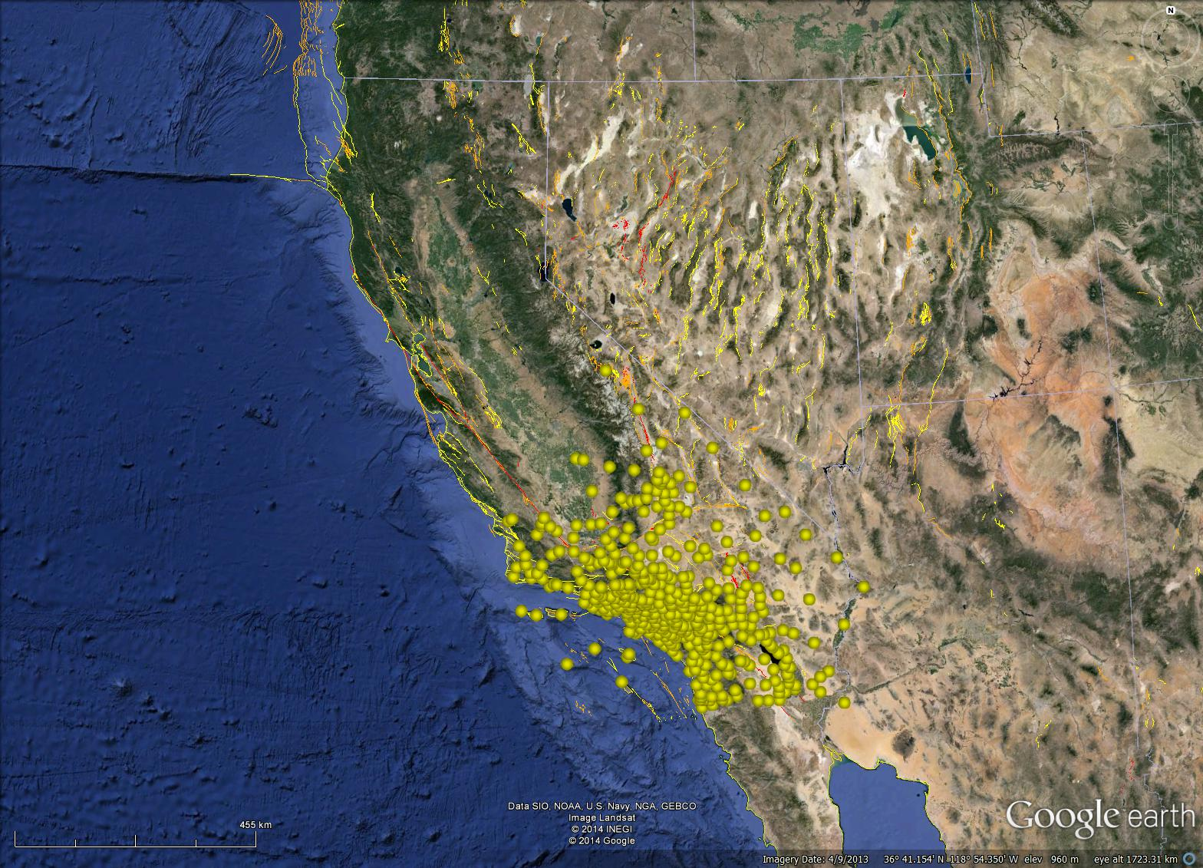
Caltech/USGS (CI) - 417

Slide 7
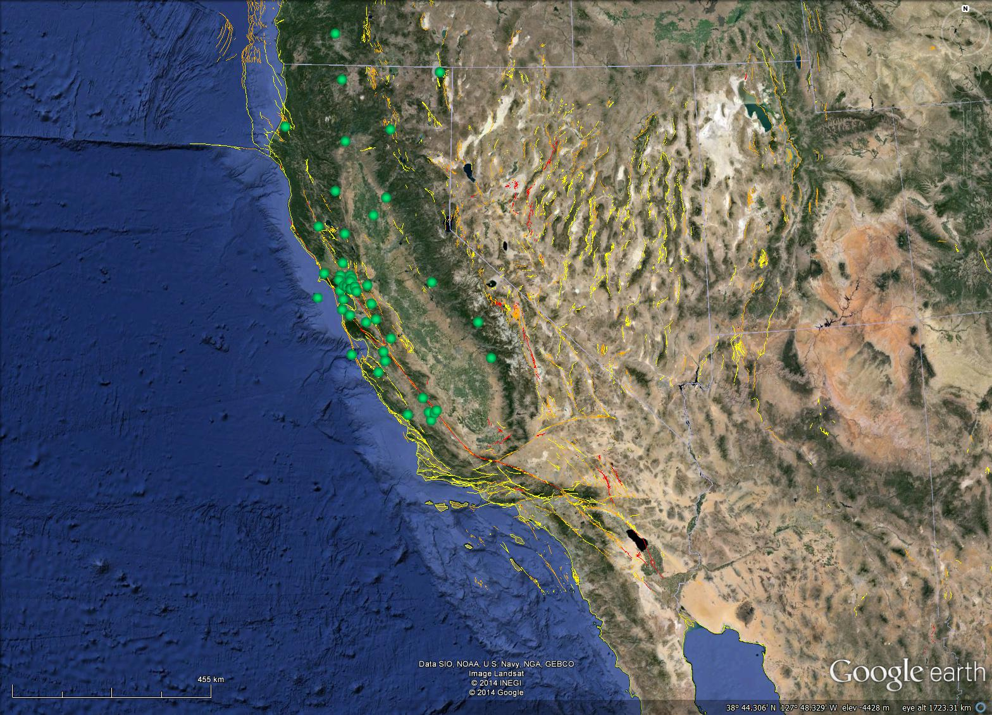
UC Berkeley (BK) - 50

Slide 8
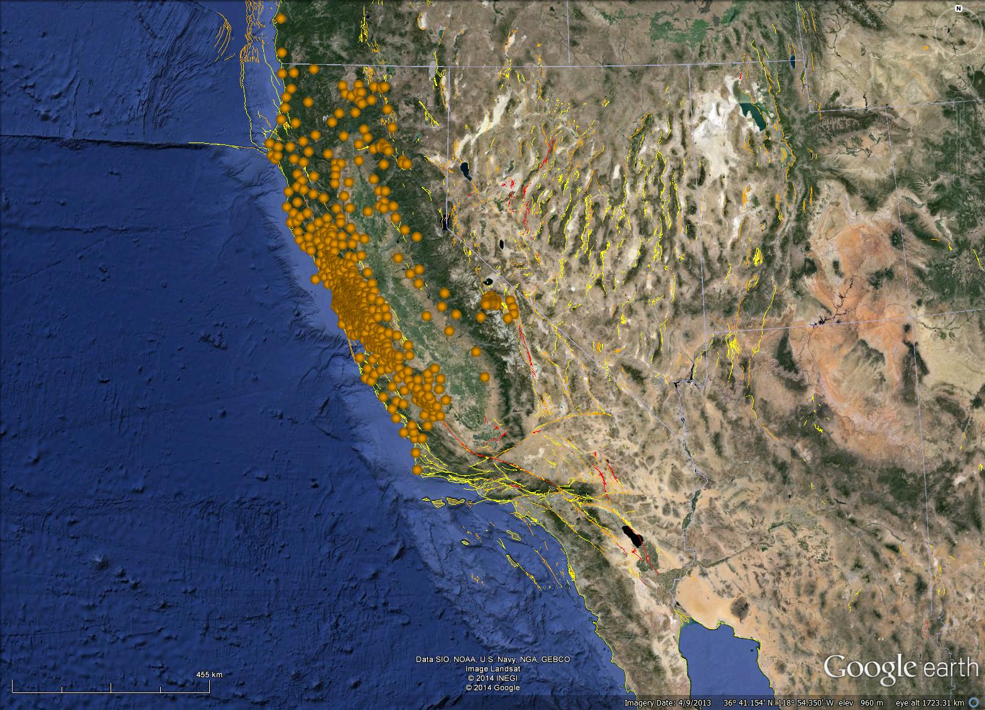
USGS NCSN (NC) - 519

Slide 9
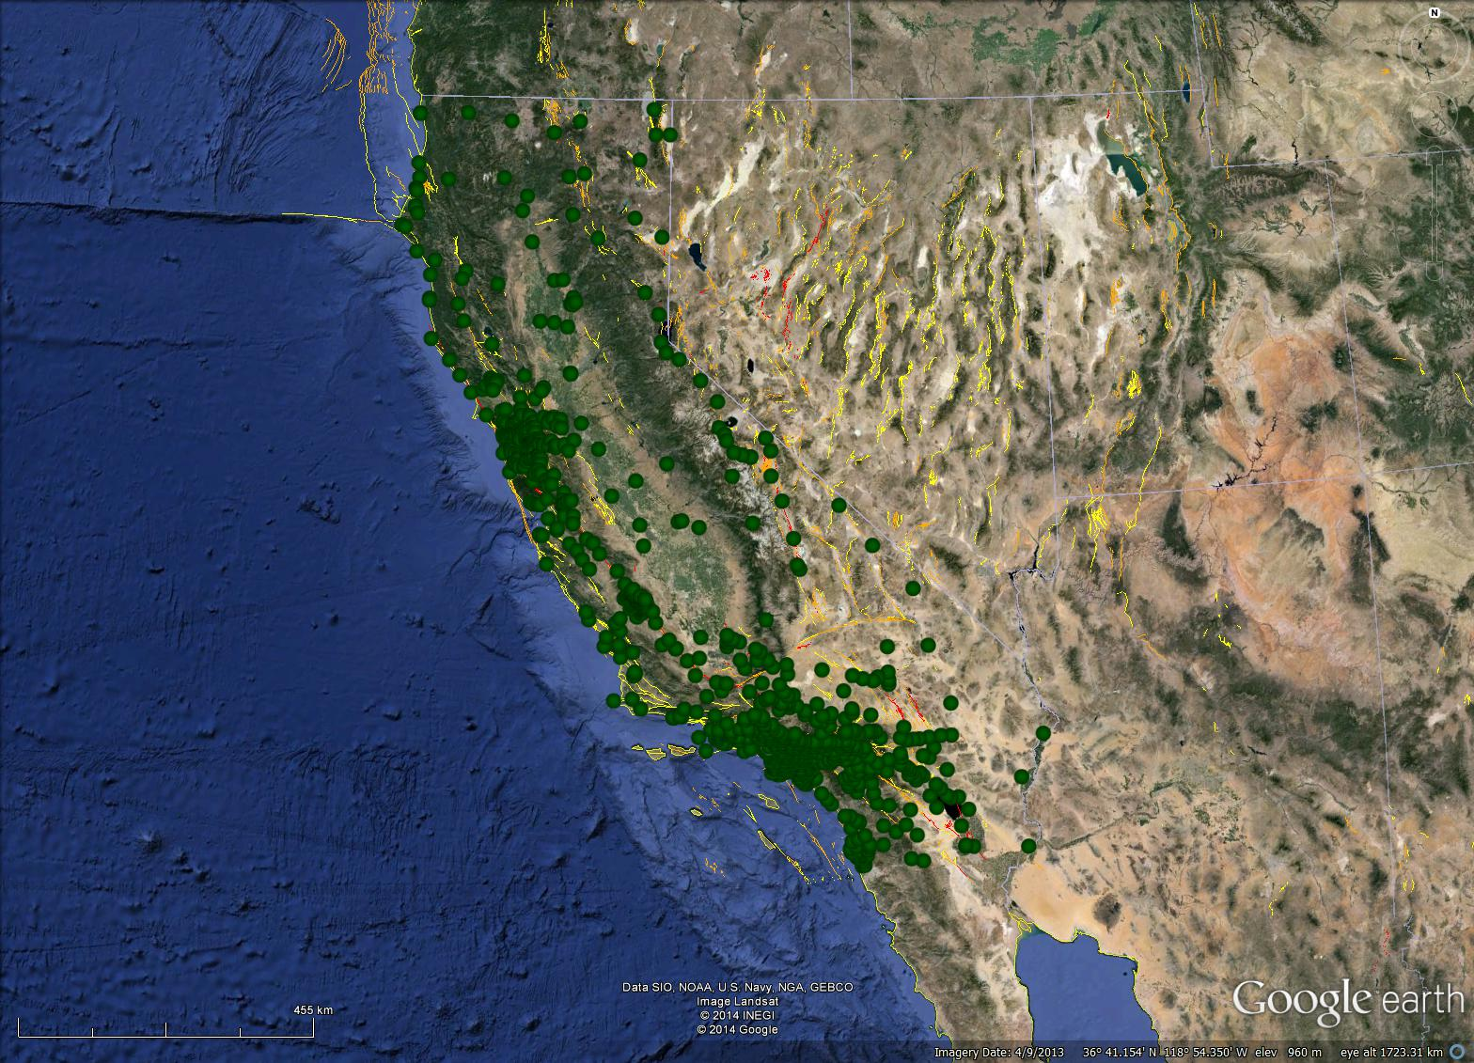
CGS (CE) - 864

Slide 10
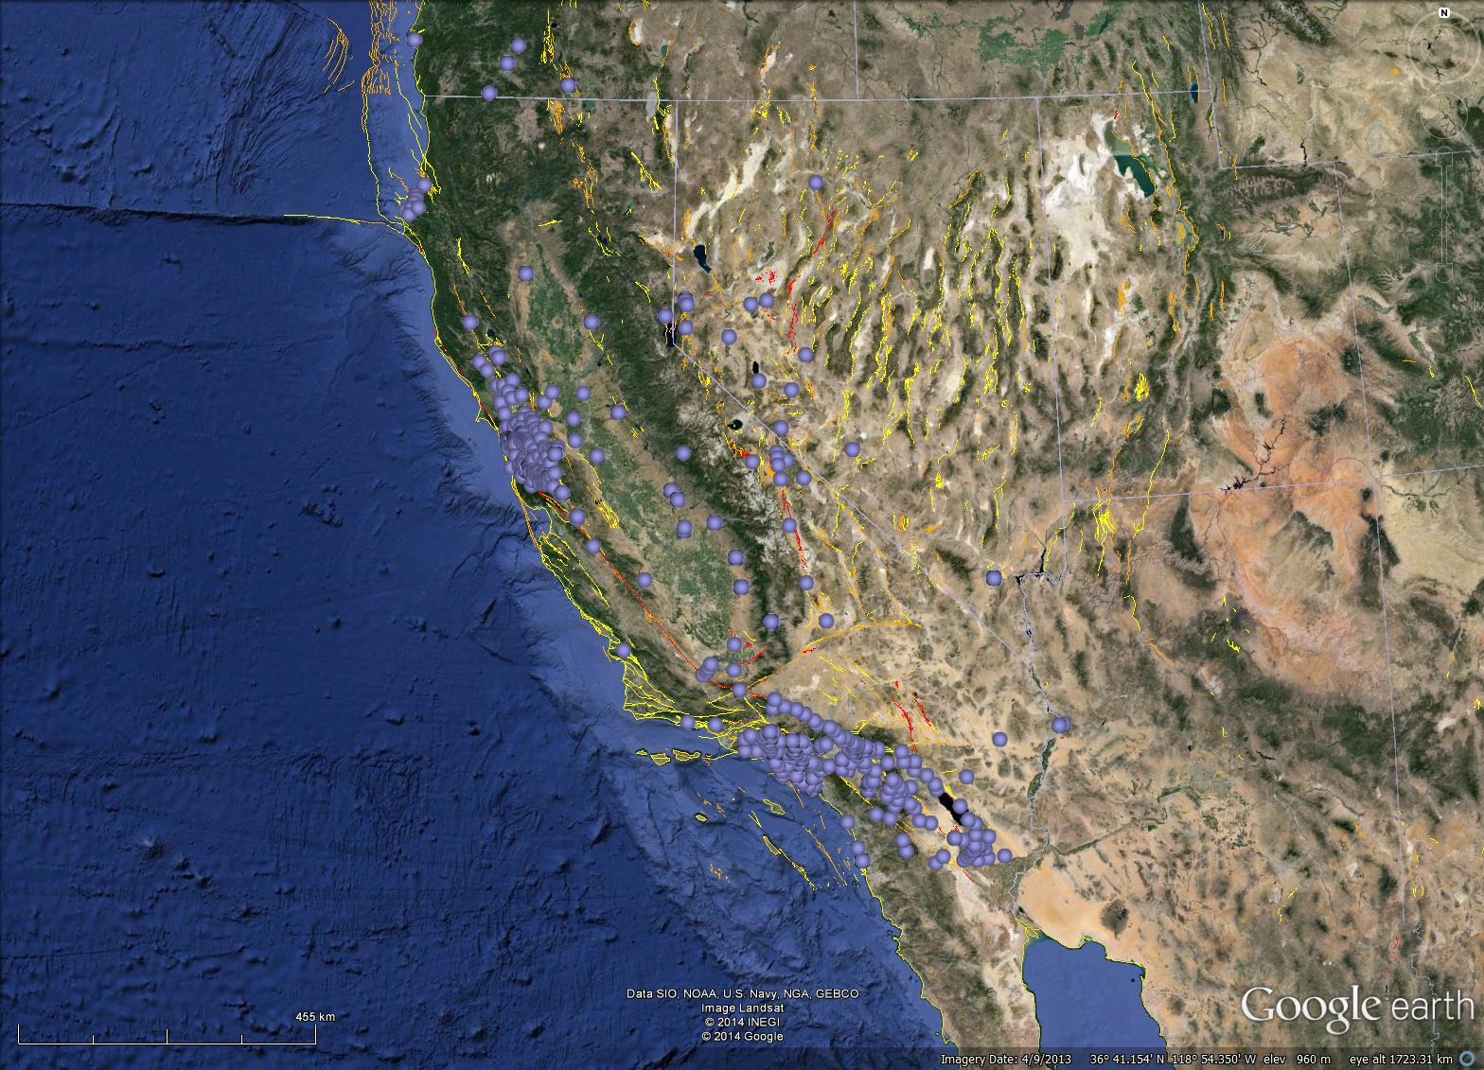
USGS NSMP (NP) - 414

Slide 11
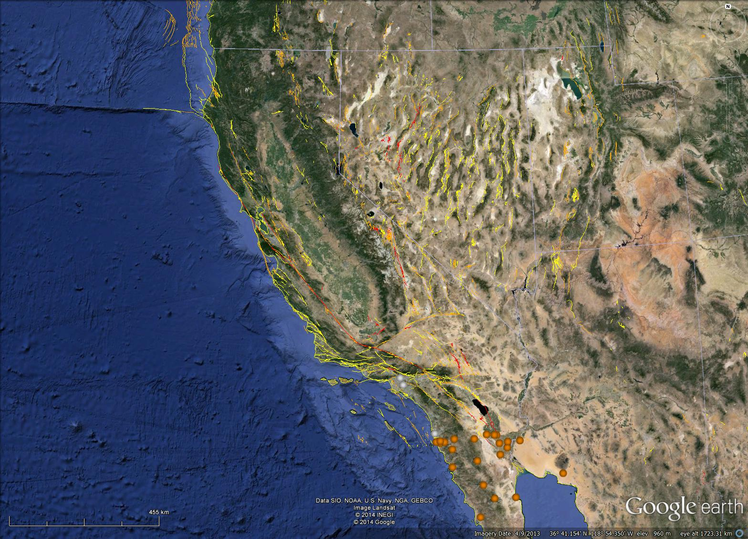
CICESE (BC) - 23

Slide 12

UCSD Anza (AZ) - 29

Slide 13

CA DWR (WR) - 15

Slide 14

PG&E (PG) - 29

Slide 15

UNR (NN) - 72

Slide 16

LBL/Calpine (BG) - 32

Slide 17

US Array (TA) - 8

Slide 18

UW (UW) - 4

Slide 19
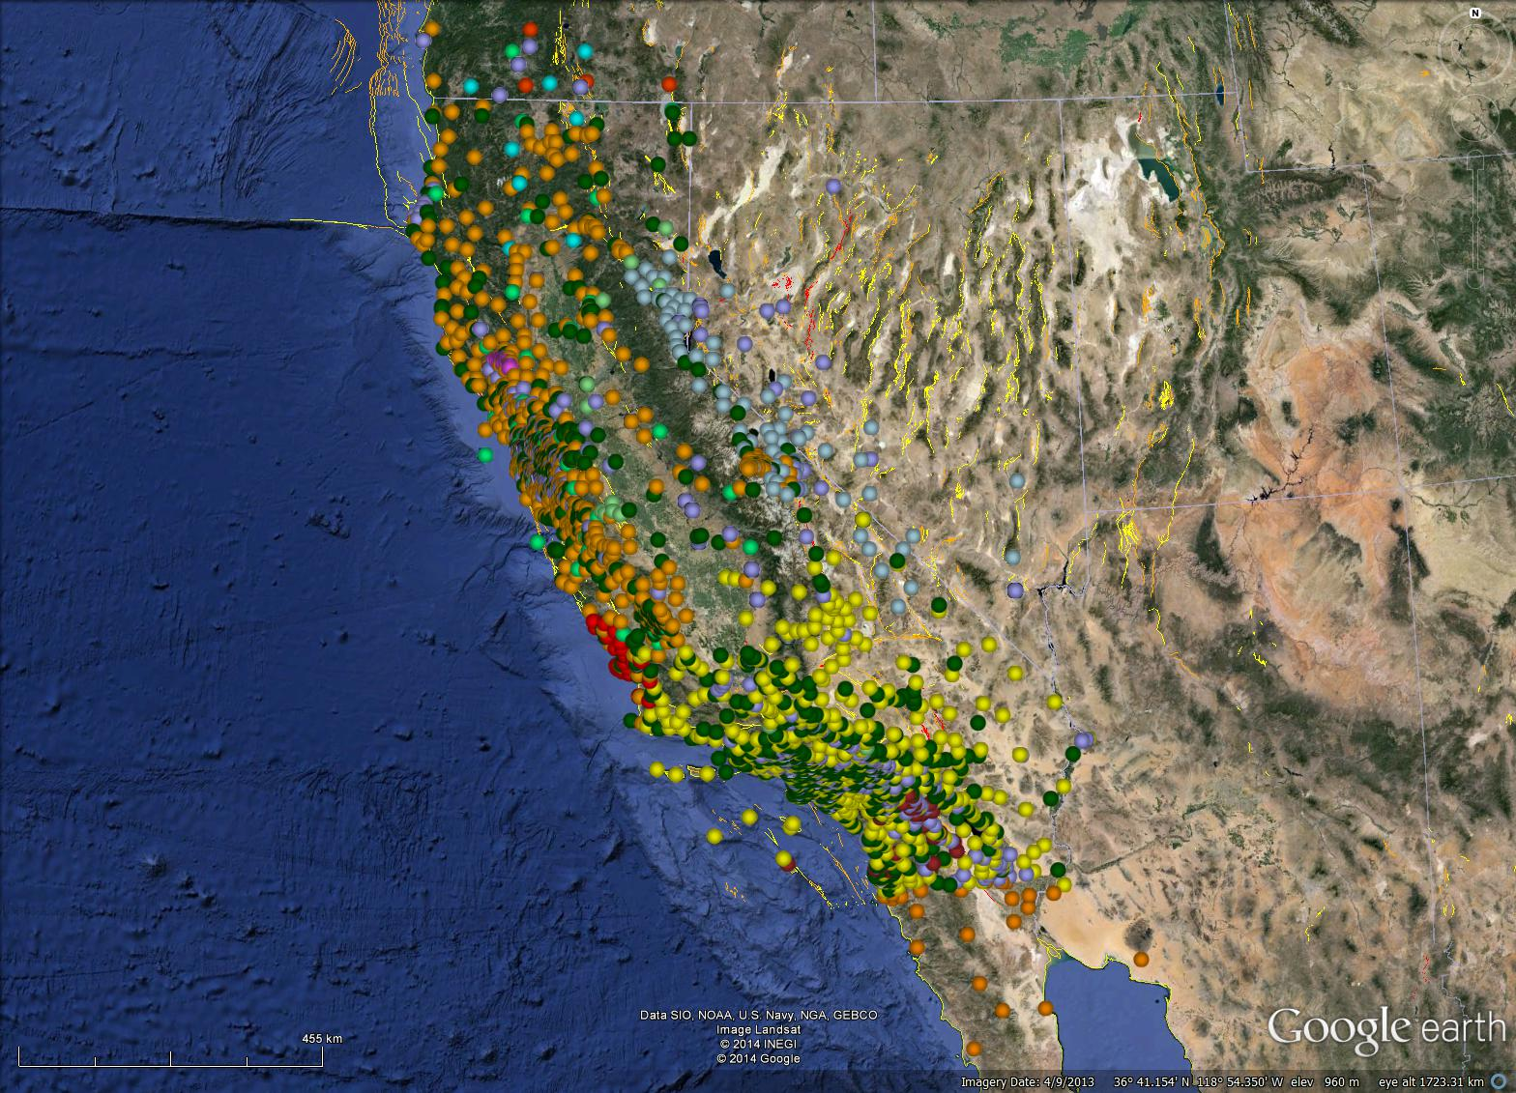
Total – 2475
(available via KML)

Slide 20
Products
Earthquake reporting and review
  Locations
  Magnitudes
  Moment tensors
  First-motion mechanisms
  ShakeMaps
  COSMOS V0-V3
  Aftershock probabilities
  Double Difference locations
  CISN Display
Software
  AQMS
  Earthworm
  Metadata management
  EEW
  NetQuakes/NetWorm
Archiving
  Event and Continuous waveforms
  Earthquake catalog
  COSMOS products

Slide 21
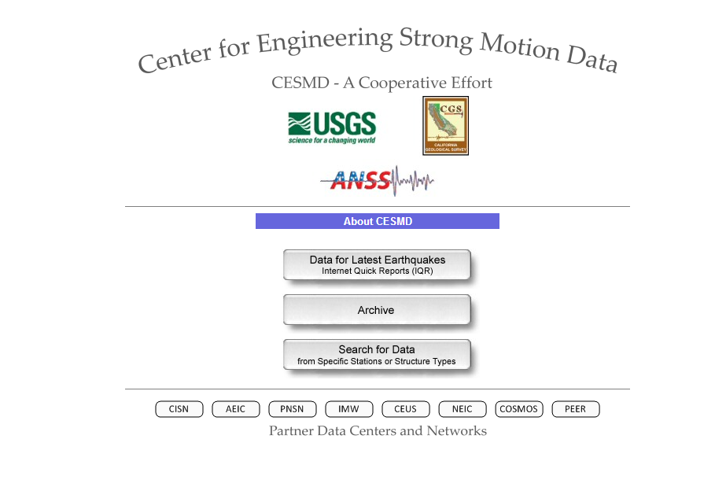
http://strongmotioncenter.org/

Slide 22
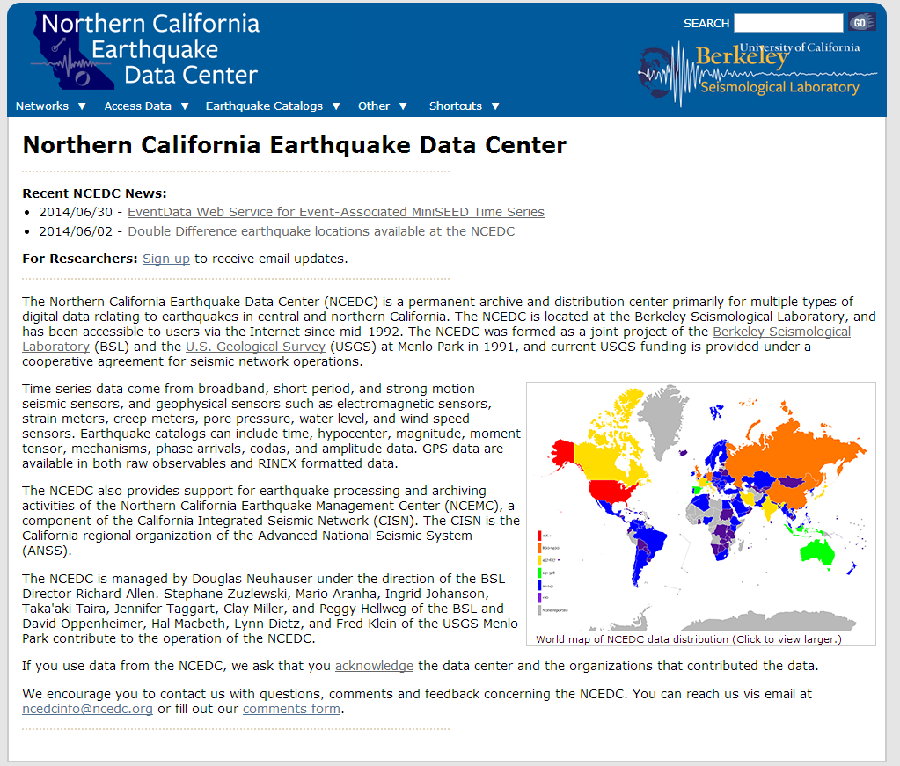
http://www.ncedc.org/

Slide 23
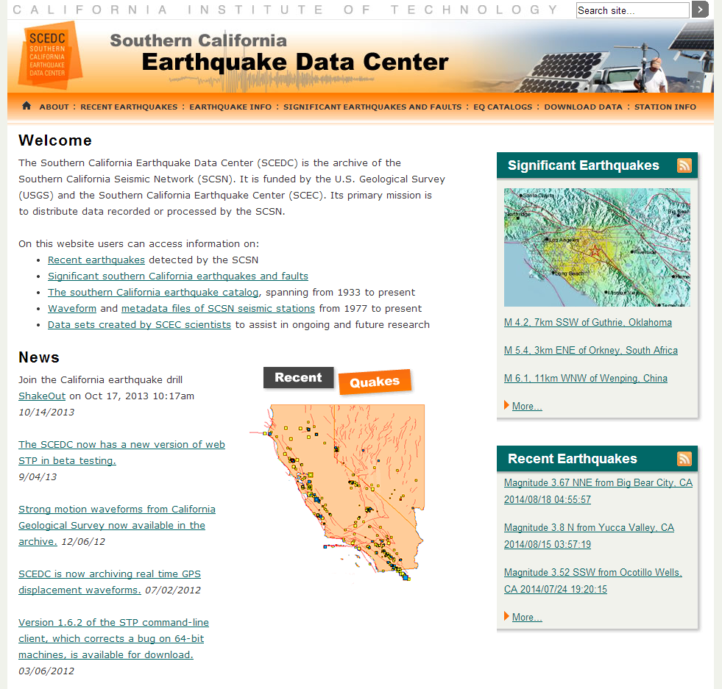
http://www.data.scec.org/

Slide 24
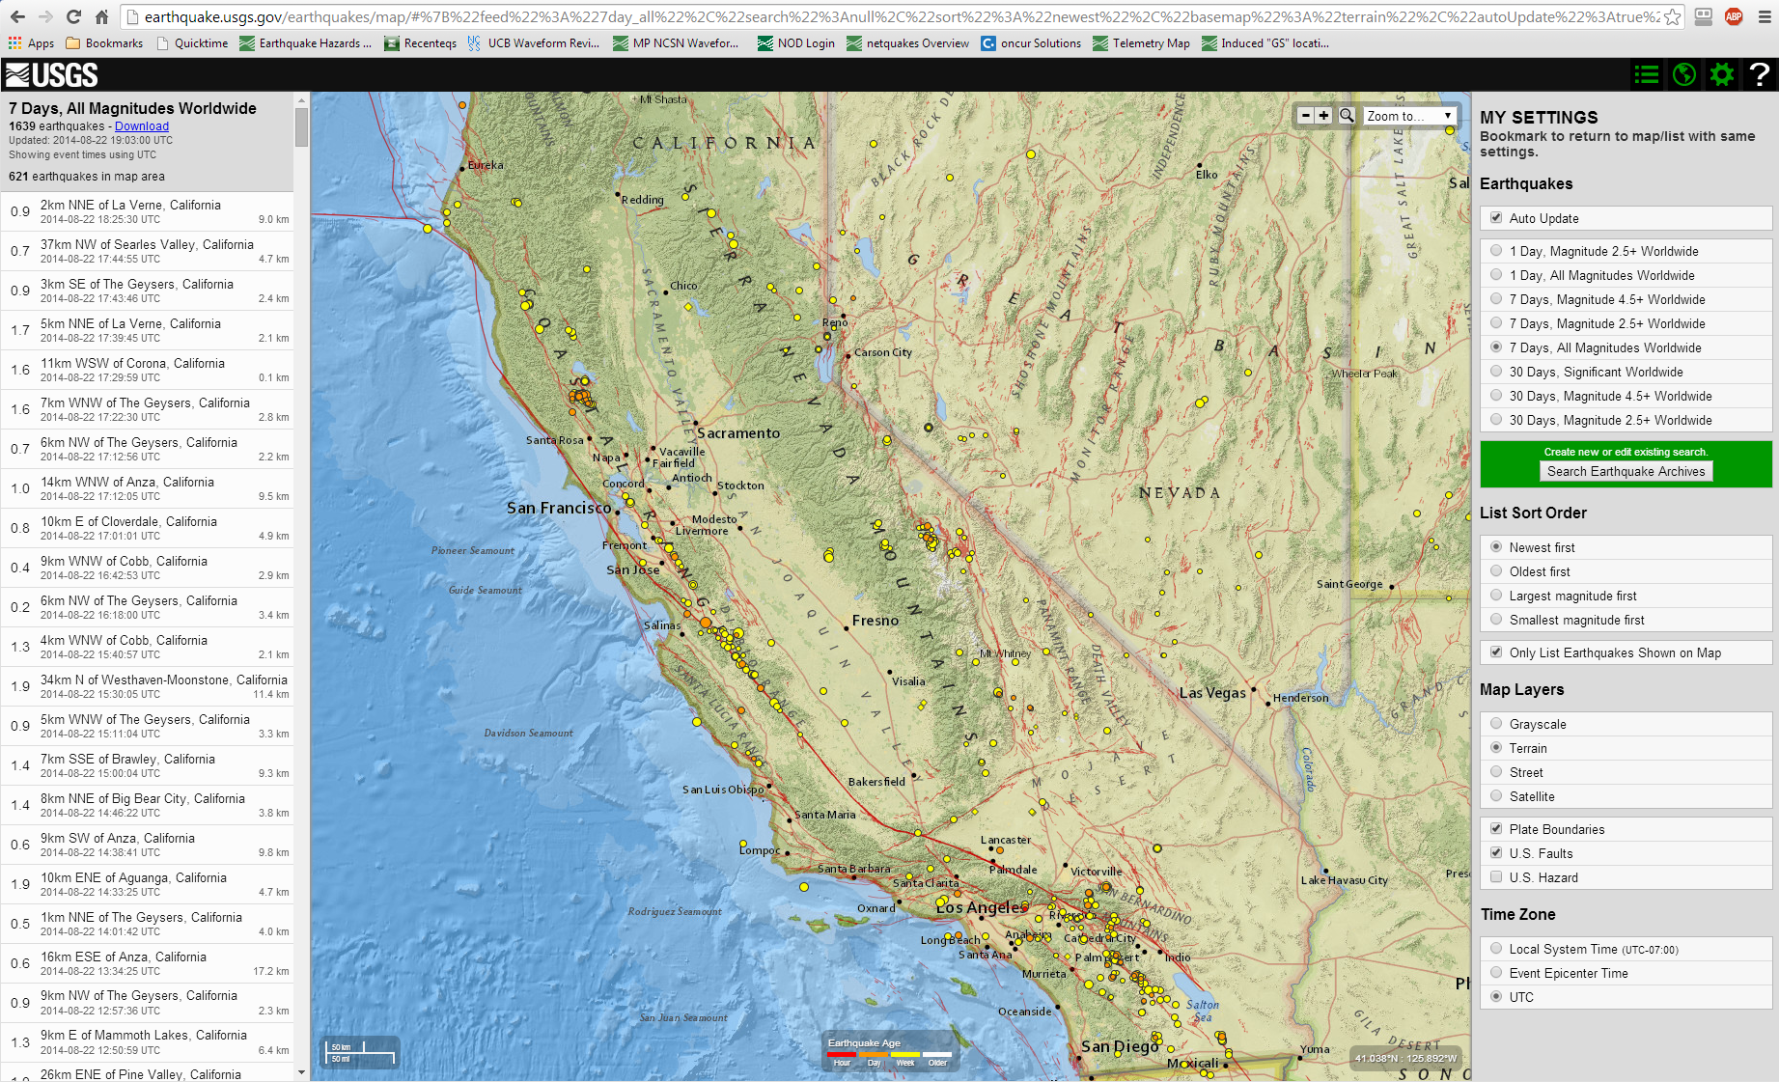
http://earthquake.usgs.gov/earthquakes/map/

Slide 25
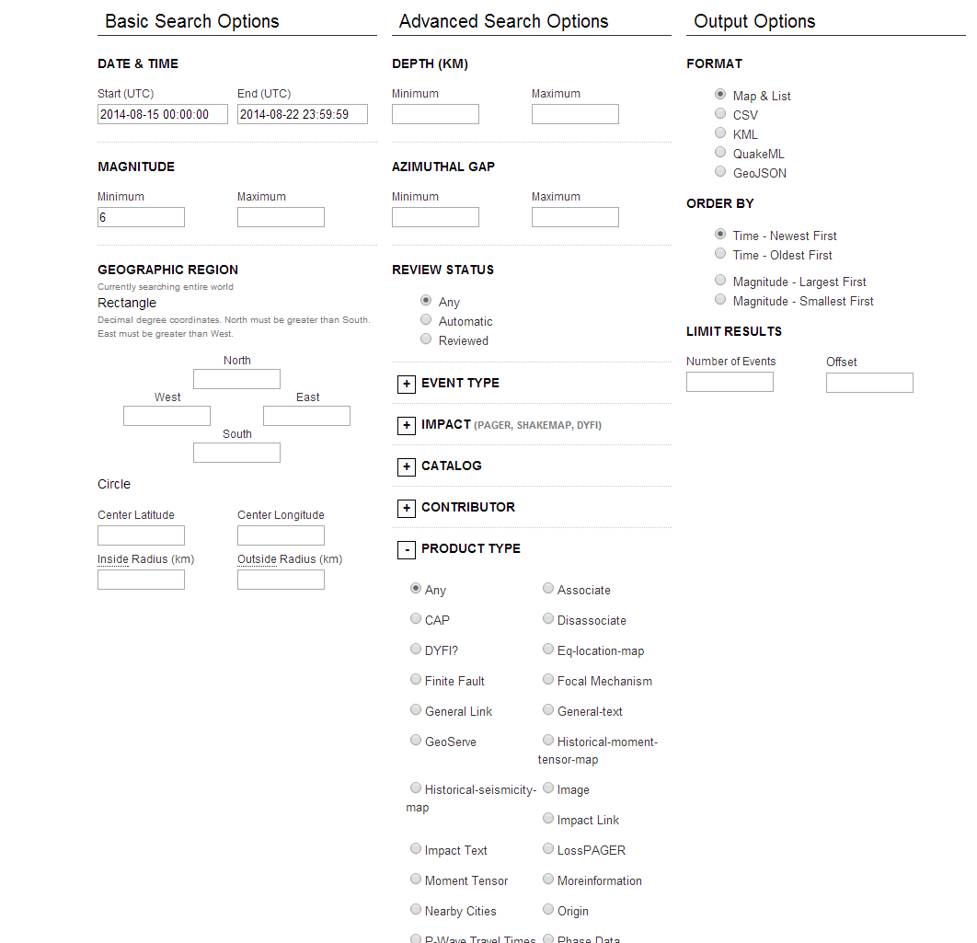
ComCat

