Slide 1
CISN Ability to Detect Induced Earthquakes
Egill Hauksson & Thomas Goebel, Caltech
10 October 2014

Slide 2
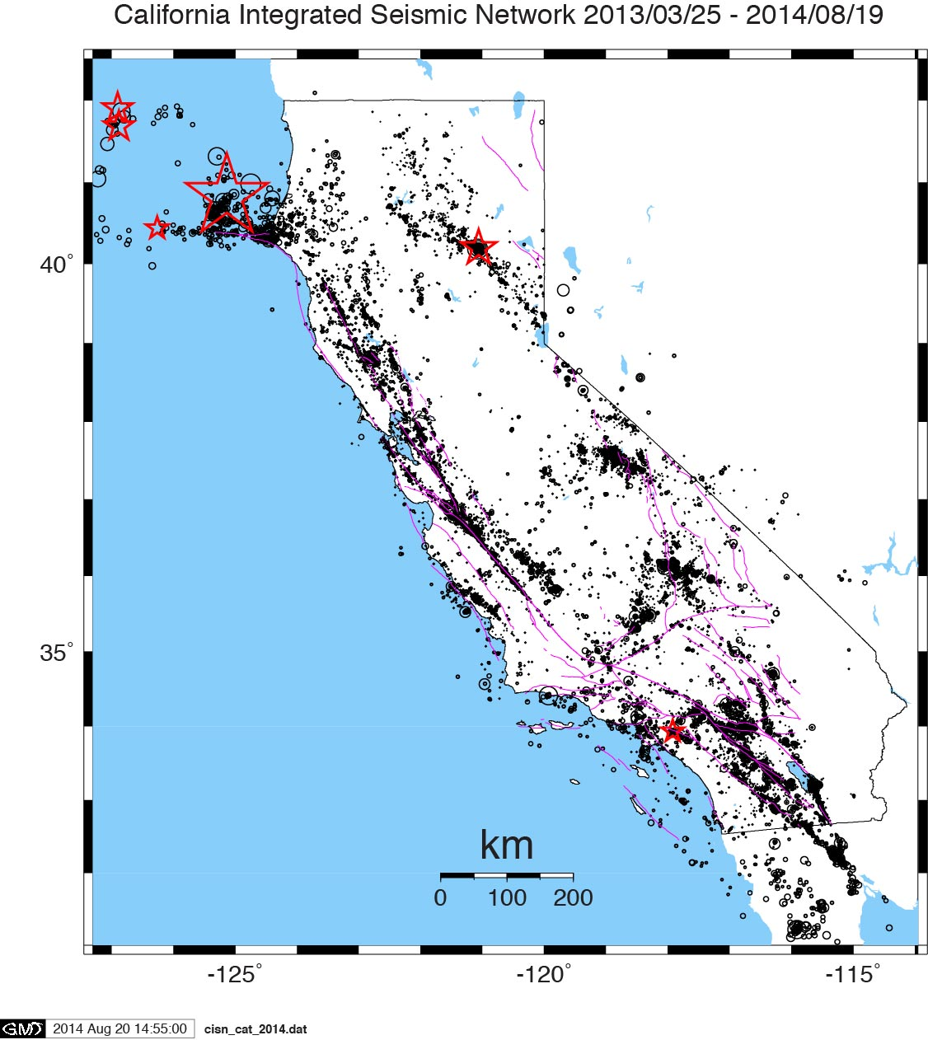
Causes of Induced Earthquakes
Geothermal Plants
Oil Fields
Los Angeles Basin
Southern San Joaquin Valley
Hydro Dams
Biosolids Management?
Notes:
M7.8 May 2008 Wenzhuang earthquake
1975 M5.7 Oroville earthquake

Slide 3
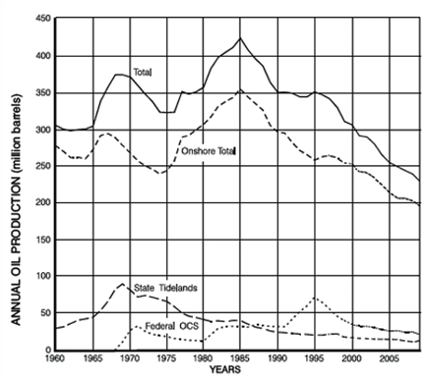
California’s oil production (CA Dept. of Conservation): 1960 - 2010
Notes:
David (Dave) Summers is a Curators' Professor Emeritus of Mining Engineering at Missouri University of Science and Technology (he retired in 2010).
http://oilprice.com/Energy/Crude-Oil/The-Oil-Beneath-California.html

Slide 4
SB4: 3160. Section 2, adding Article 3, Well Stimulation
Jason Marshall, chief deputy director of the state Department of Conservation, said the regulations will now require well operators to conduct real-time monitoring of the California Integrated Seismic Network while well-stimulation activity is taking place, as well as for 10 days afterward. If an earthquake of 2.0 magnitude or greater occurs during that time, the well stimulation activity must stop, and further activity at that site would not be permitted until an analysis is conducted to determine whether the drilling activity may have contributed to triggering the earthquake.
Notes:
http://www.spencerfane.com/environmental_law_solutions/blog.aspx?entry=582

Slide 5
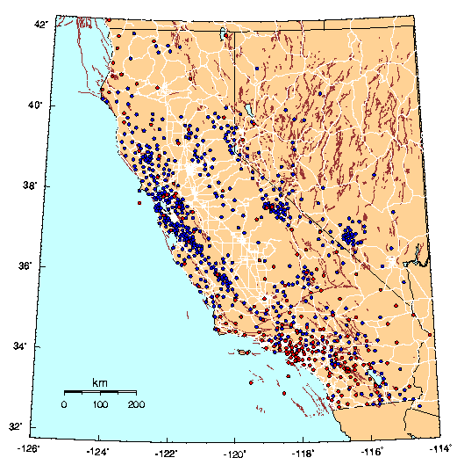
CISN

Slide 6
Greater Los Angeles Area
1971
1994
2014
1933
Notes:
These quakes are spread all over the region and no one fault system is more active than others

Slide 7
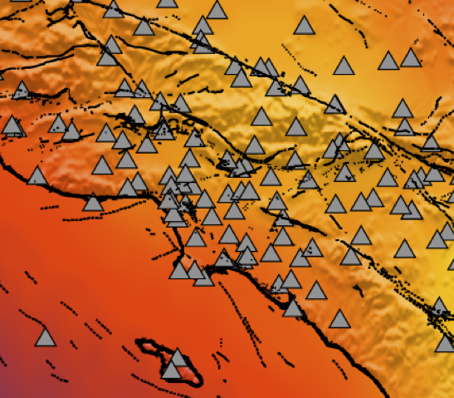
Probabilistic magnitude of completeness map
Notes:
Probabilistic magnitude of completeness map, based on the raw data only.
The color bar indicates the probabilistic magnitude of completeness and triangles indicate the location of the stations, which were active on the 1/1/2006.
Problems:
Ventura basin, + offshore
Central Valley – south
Activity of WD and fracking is recent
Different types of hydraulic fracturing
Type of fracking – depends on rock – fracking within reservoir – limestone zero – permembility. Large fracture for fluid path ways.
Why is the activity so low – only a handfull possibly induced sequences.
Three dirreencrce – 1) how they do fracking; 2) rock type ; tight shale limestoen or porous snad stone. 3) stress field probe – basin far from failure – intraplate everything close to failure.
CA – only small fractures -- increasing pre-existing permeability a little bit.
-- Acid flooding
OK– create new network of fractures substantial

Slide 8
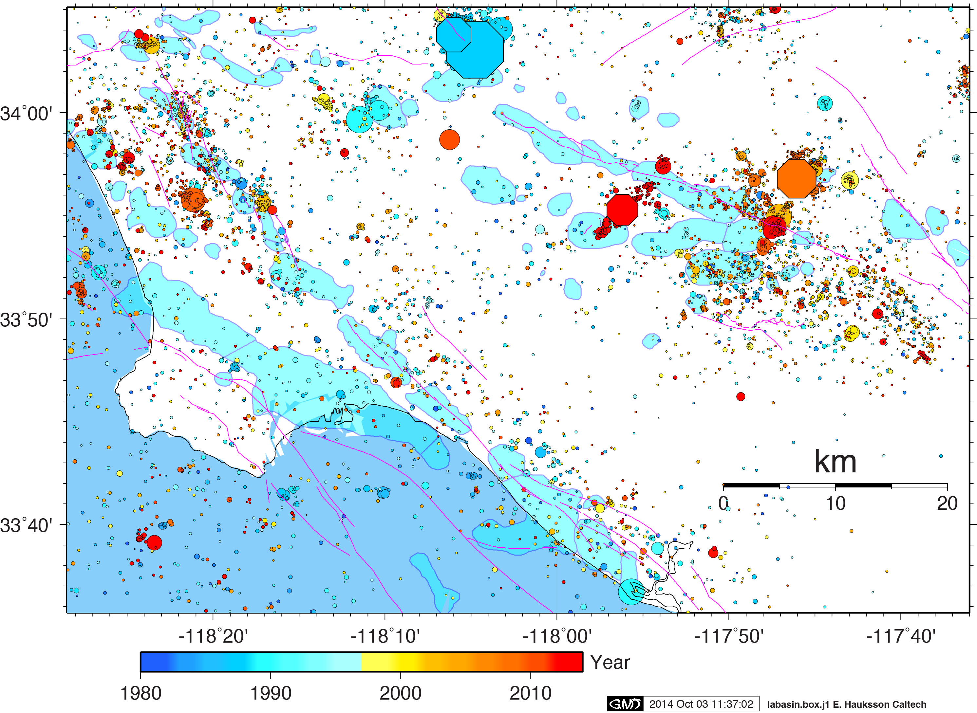
Notes:
71 oil fields in the Los Angeles basin
Oil fields cover about 18% of the greater LA Basin square area
About 18% of the seismicity occurs within the oil fields.
[wood2:sun_04/LA_oil_2014/All_lab] hauksson% wc *j1
1239 24780 142485 la-oil-field_cat.j1
5856 117120 913536 lab-no-oil.j1
7095 141900 815925 labasin.box.j1
14190 283800 1871946 total

Slide 9
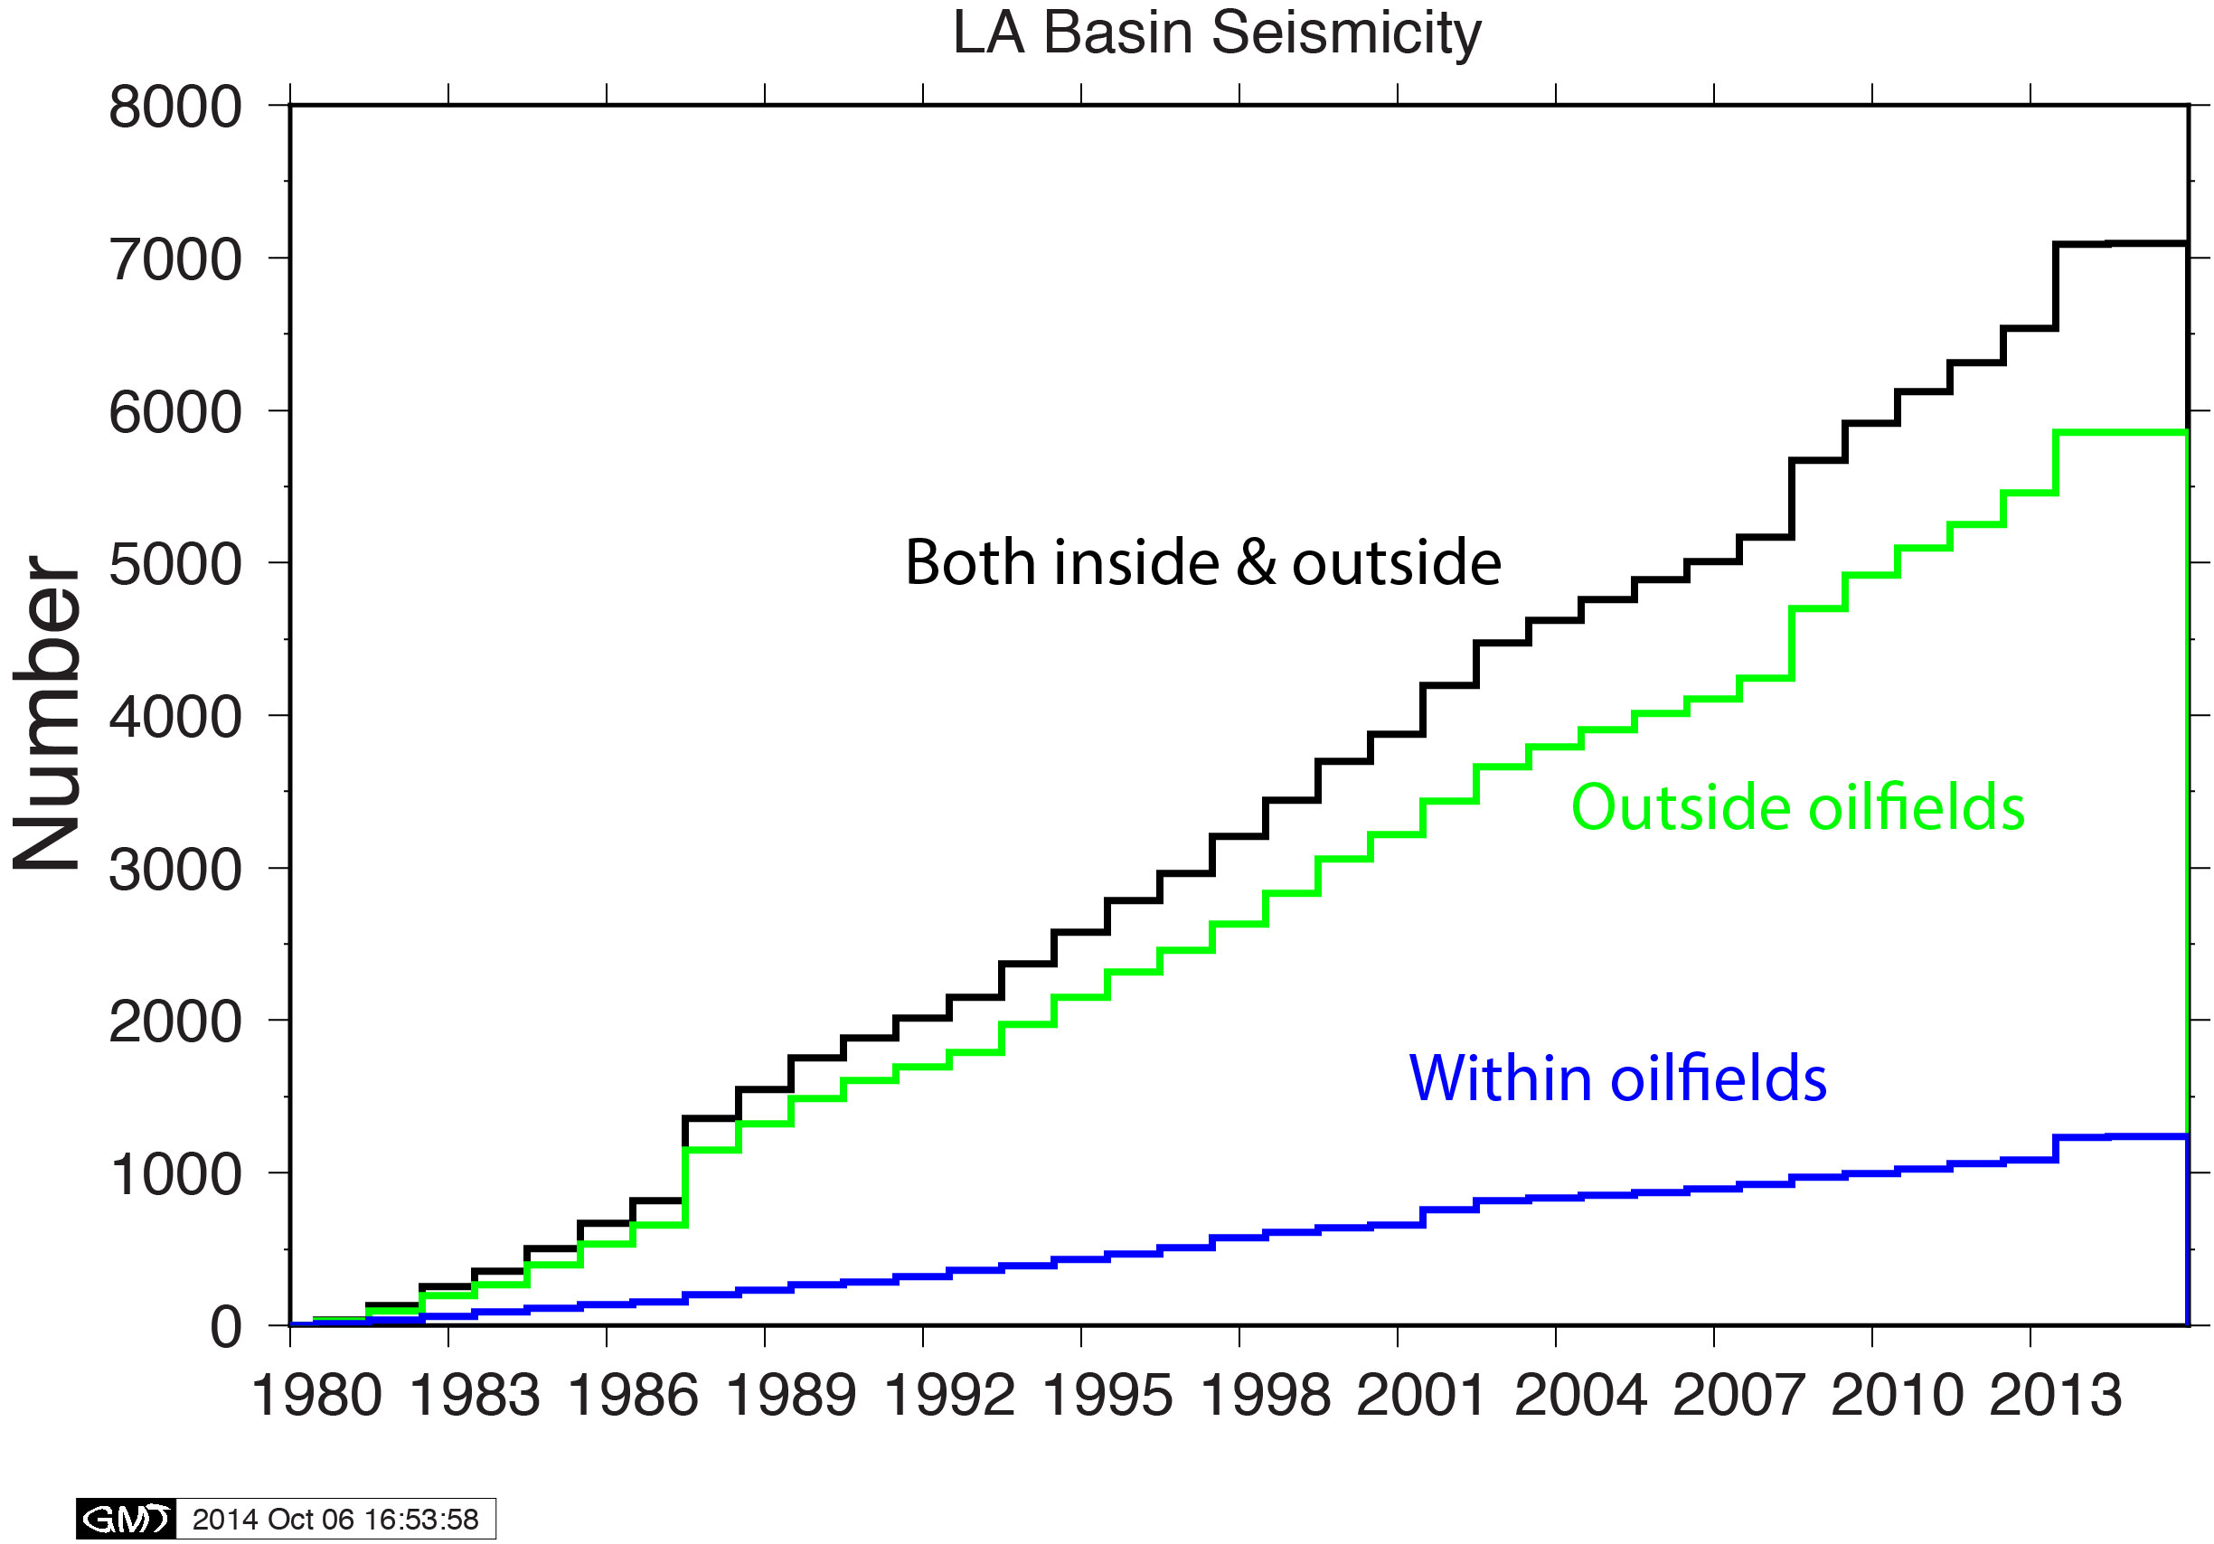
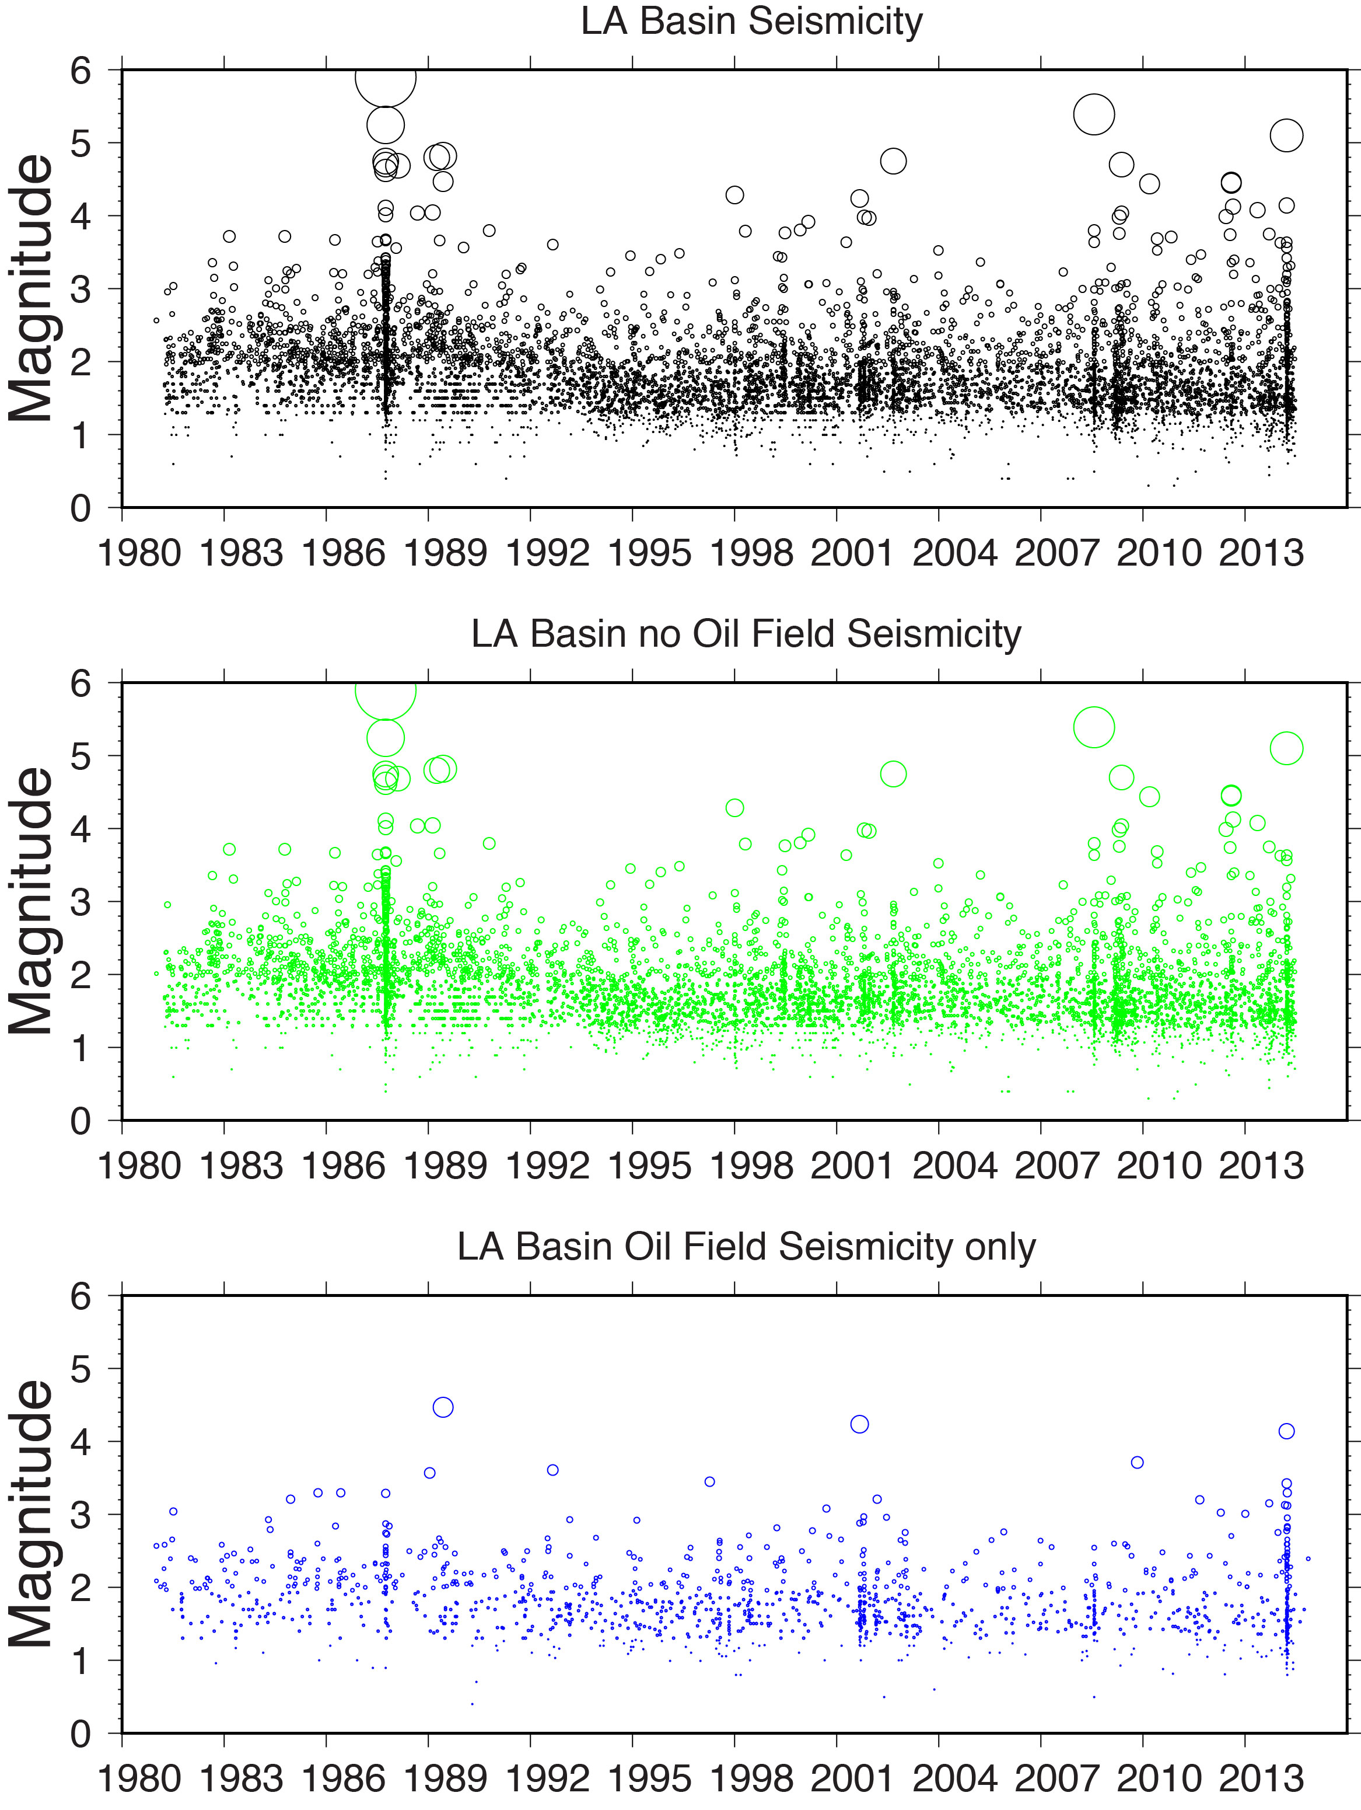
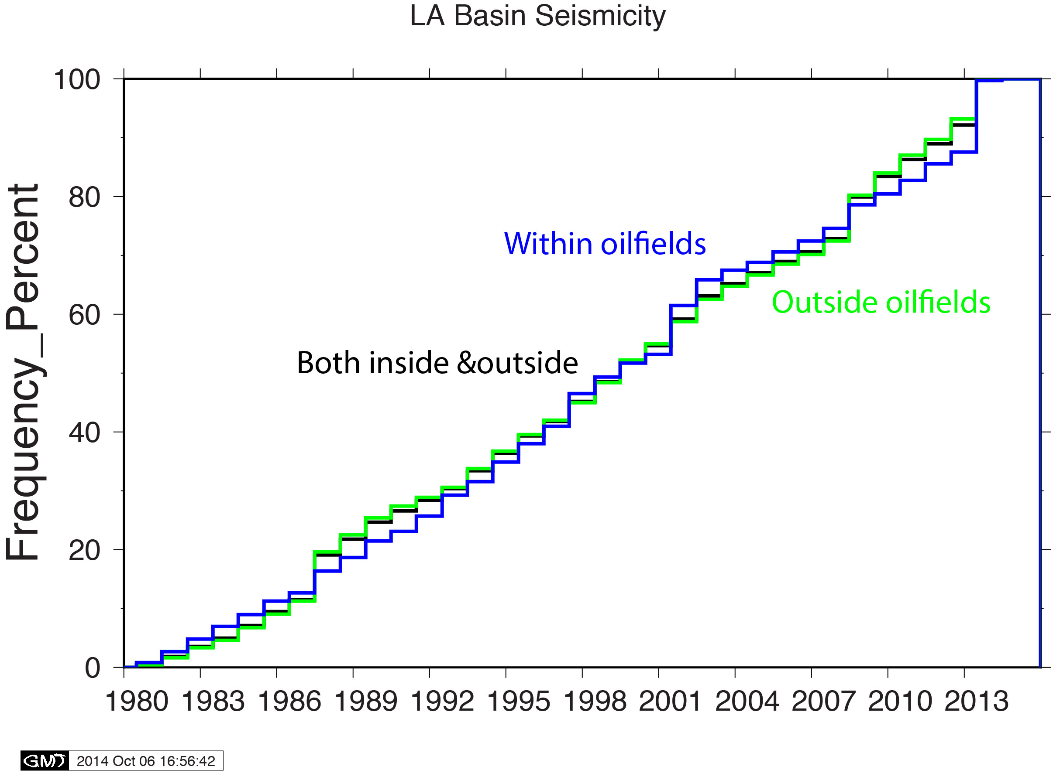
Los Angeles Basin

Slide 10
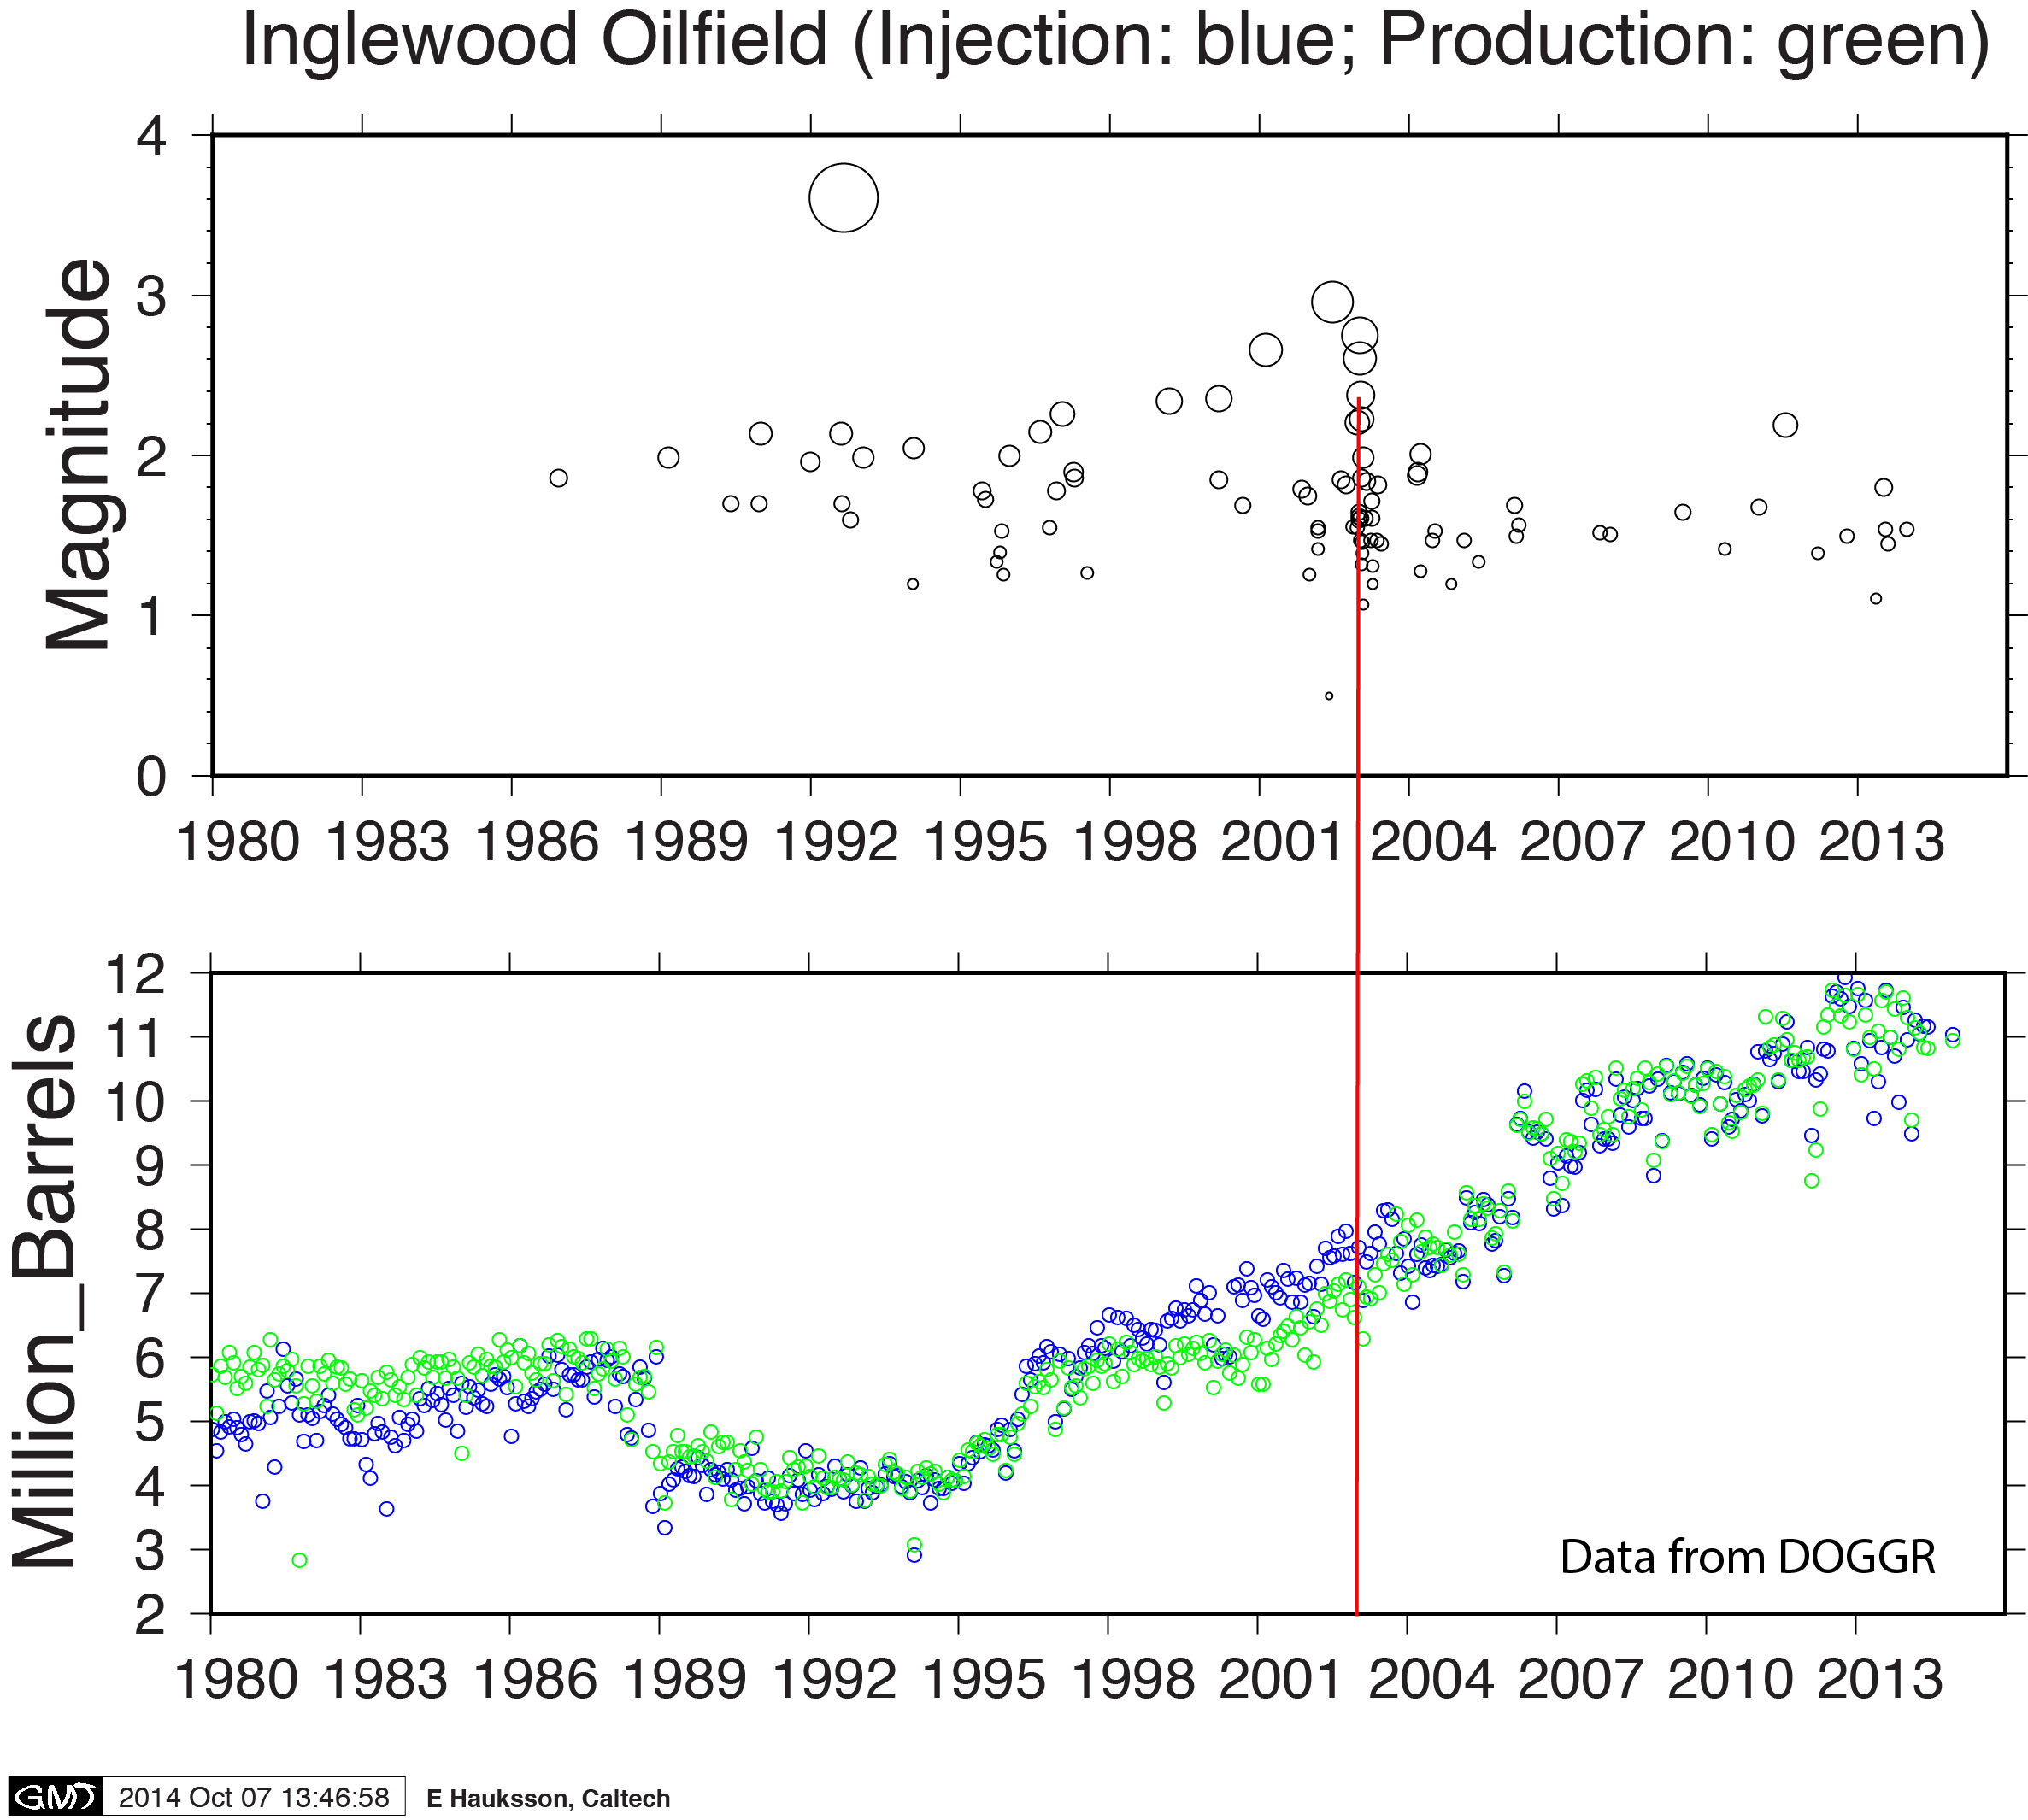
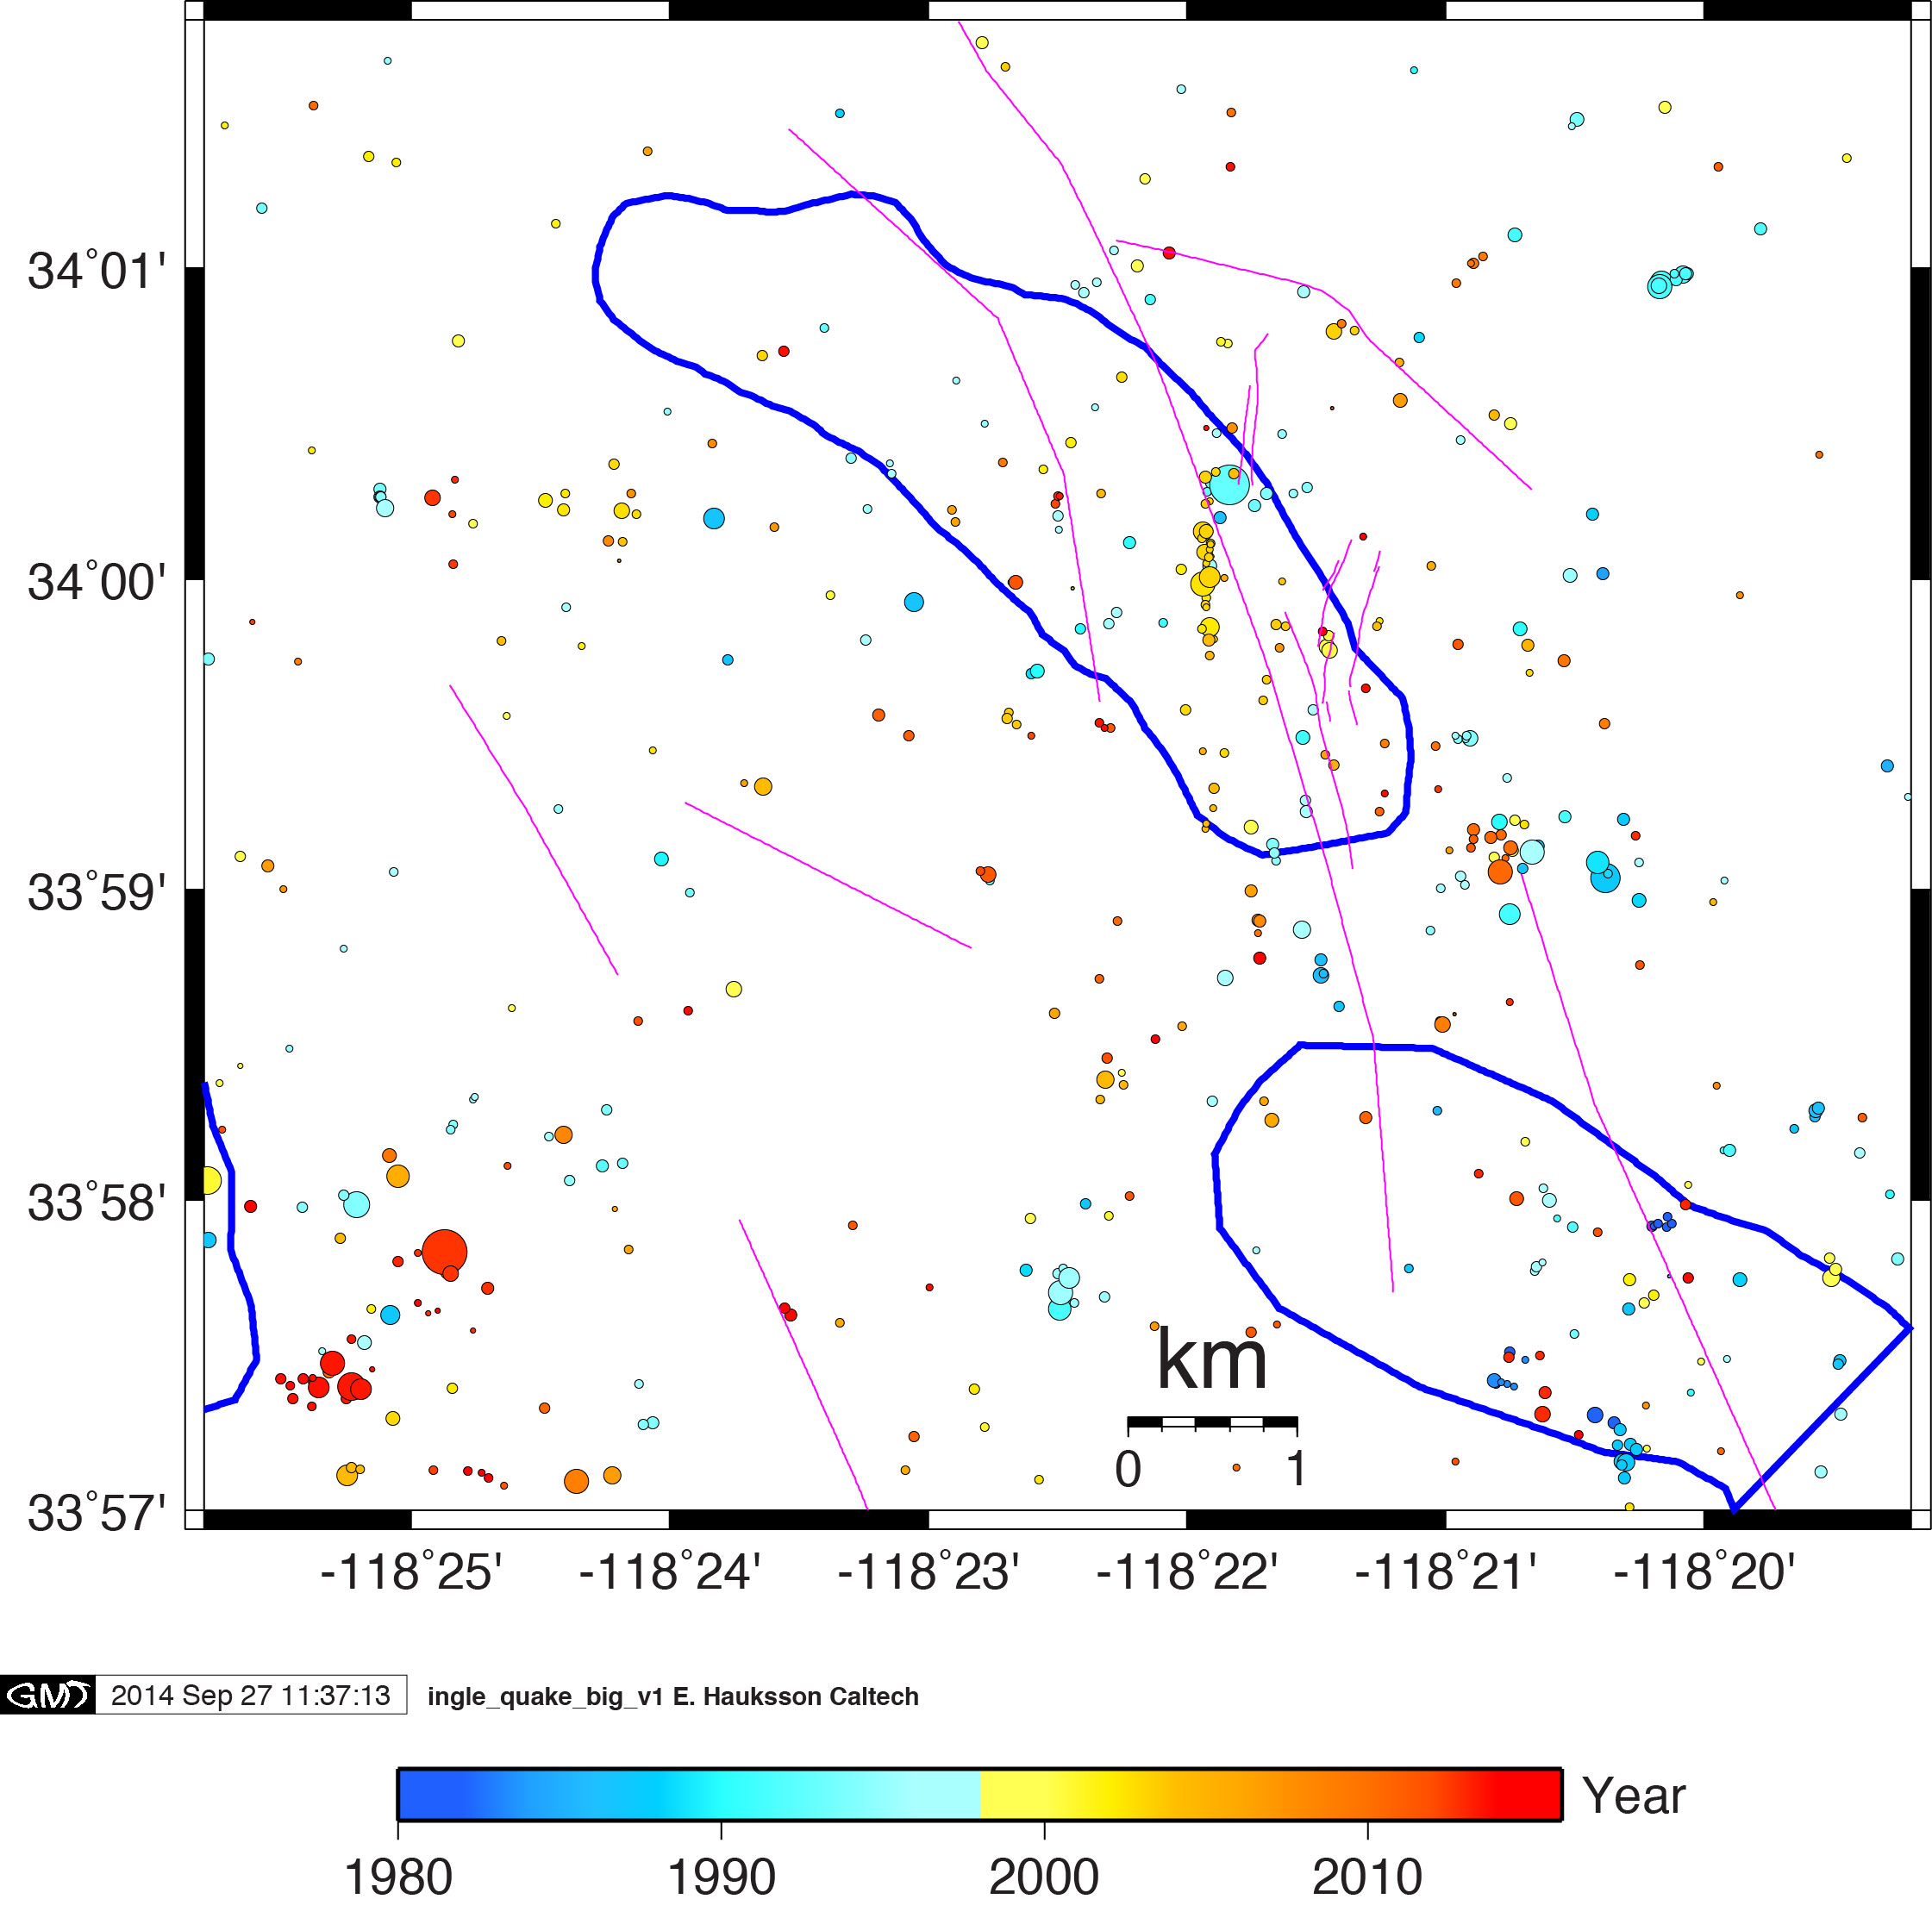
Inglewood Oil Field

Slide 11
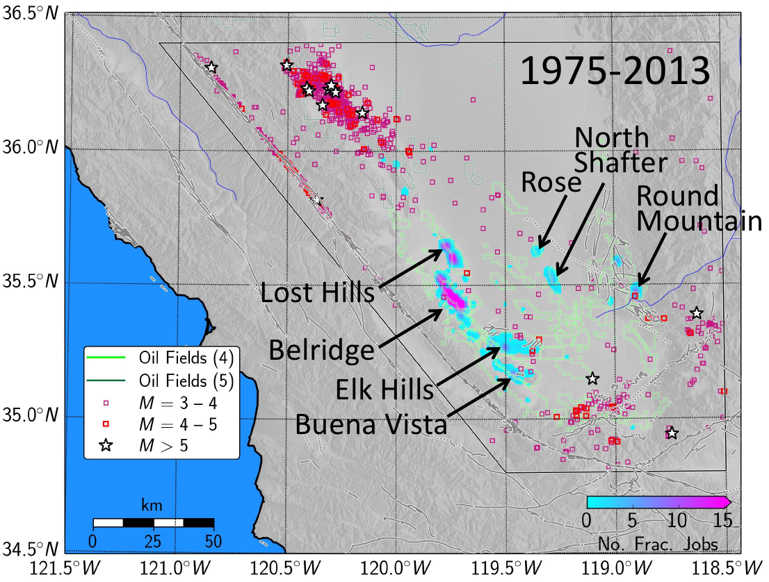
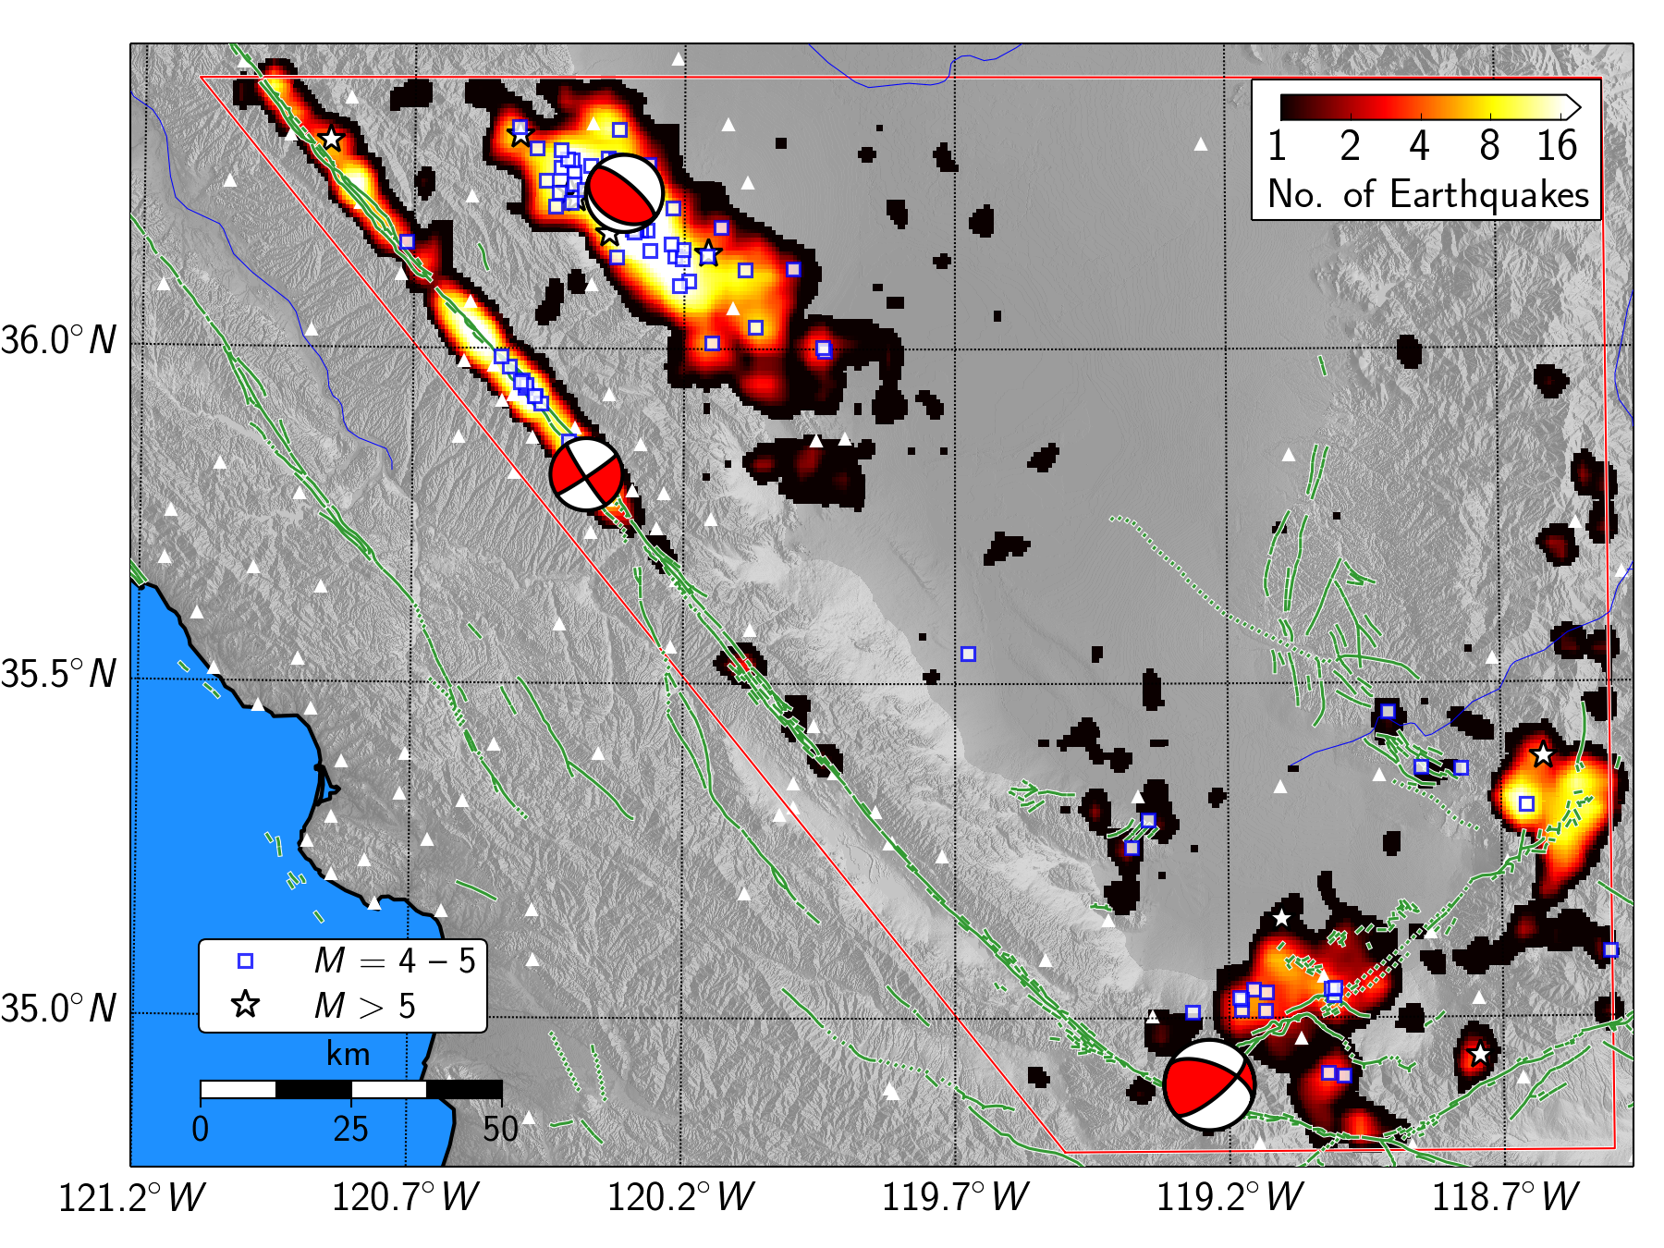
Frack jobs
Notes:
Hydrologic fracturing activity -- most in Belridge – almost nothing in Tejon
Started in -- only data since Jan 2014 this year.
Excel sheet – list wells hydraulic fracturing ---
DOGr

Slide 12
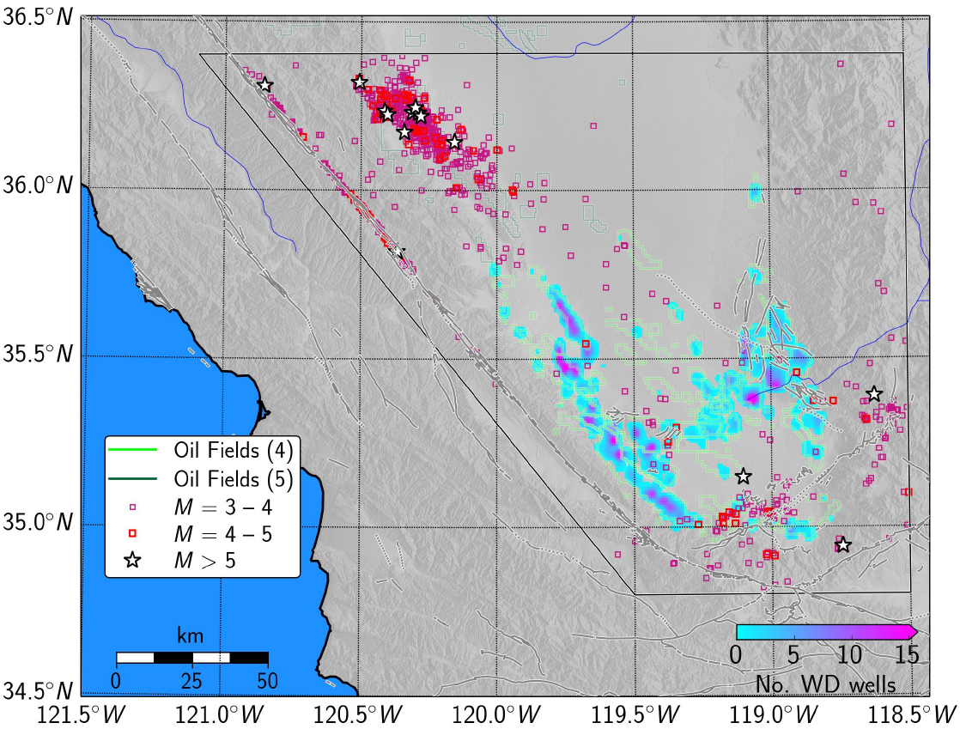
Waste Disposal Wells
Notes:
Waste water disposal wells – going on for longer time frame – since when 1977 when DOGR records start?? Low injection rate in 1970s and early 1980s.
Recent issue of low quality reservoirs that have a lot of water with oil -- some by-product of secondary stimulation – flooding, hydraulic fracturing steam flooding.

Slide 13
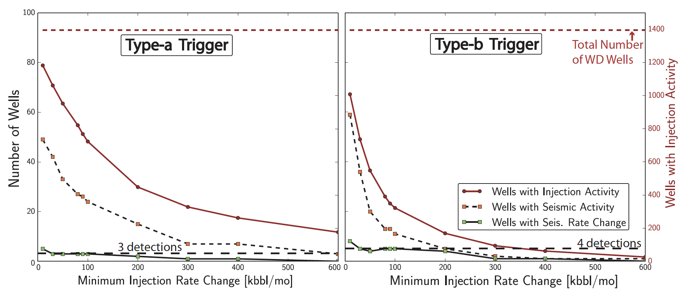
Southern San Joaquin Valley

Slide 14
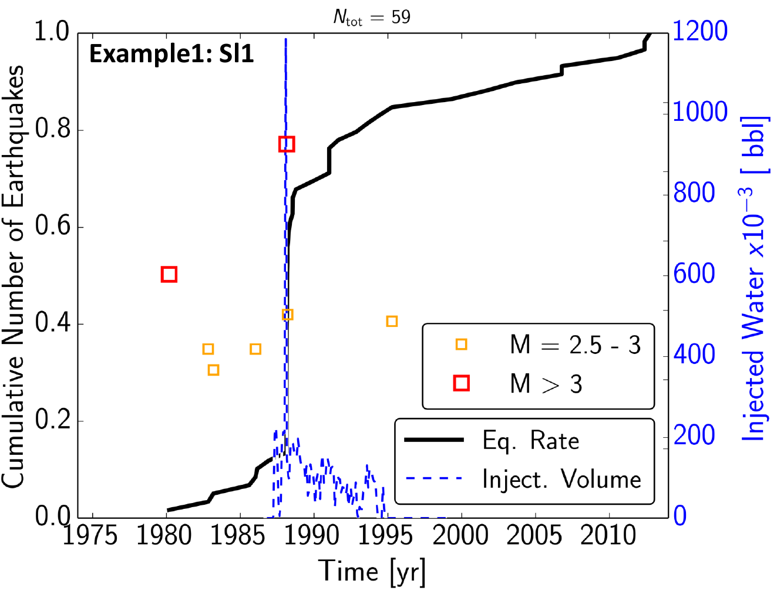
Central Valley
Notes:
Northwest Kern county –
Lost Hills oil field nearby
Figure 4. Injection rates (blue), cumulative earthquake number (black) and earthquake
magnitudes (colored squares) within a 10 km radius of injection well Lh.

Slide 15
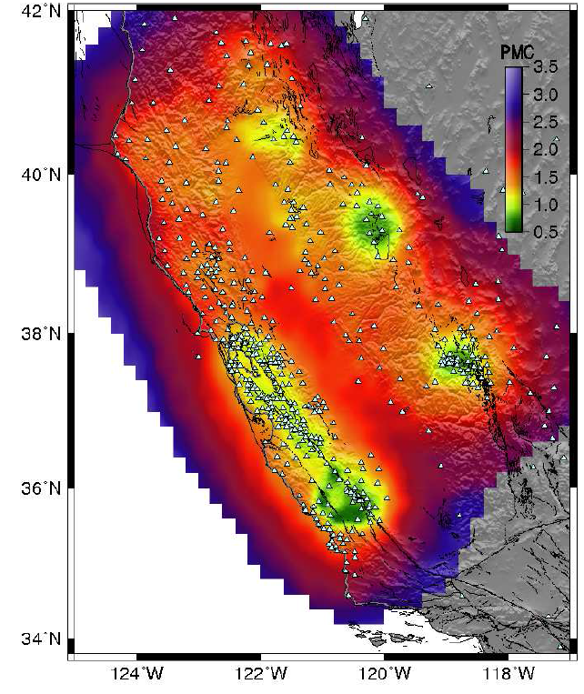
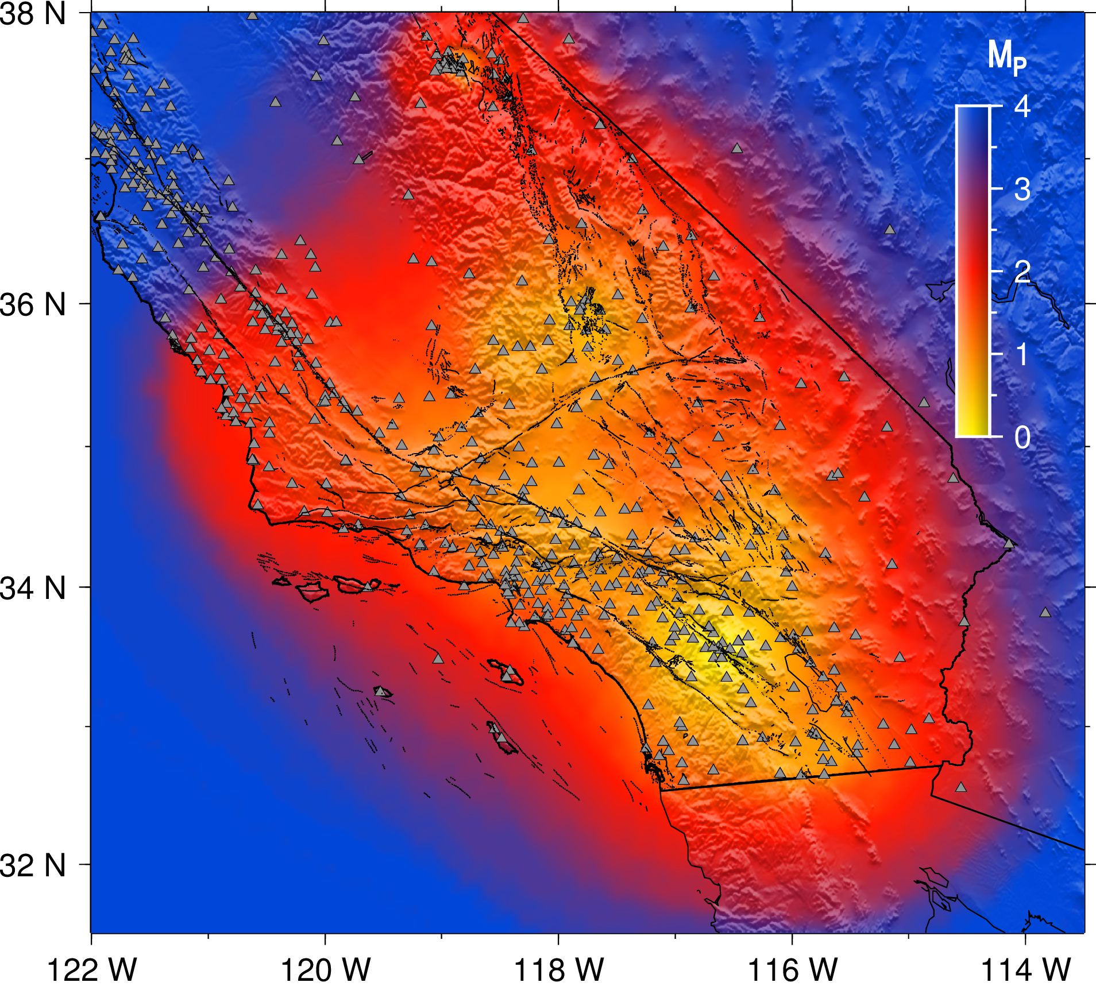
Probabilistic magnitude of completeness maps
Notes:
Probabilistic magnitude of completeness map, based on the raw data only.
The color bar indicates the probabilistic magnitude of completeness and triangles indicate the location of the stations, which were active on the 1/1/2006.
Problems:
Ventura basin, + offshore
Central Valley – south
Activity of WD and fracking is recent
Different types of hydraulic fracturing
Type of fracking – depends on rock – fracking within reservoir – limestone zero – permembility. Large fracture for fluid path ways.
Why is the activity so low – only a handfull possibly induced sequences.
Three dirreencrce – 1) how they do fracking; 2) rock type ; tight shale limestoen or porous snad stone. 3) stress field probe – basin far from failure – intraplate everything close to failure.
CA – only small fractures -- increasing pre-existing permeability a little bit.
-- Acid flooding
OK– create new network of fractures substantial

Slide 16
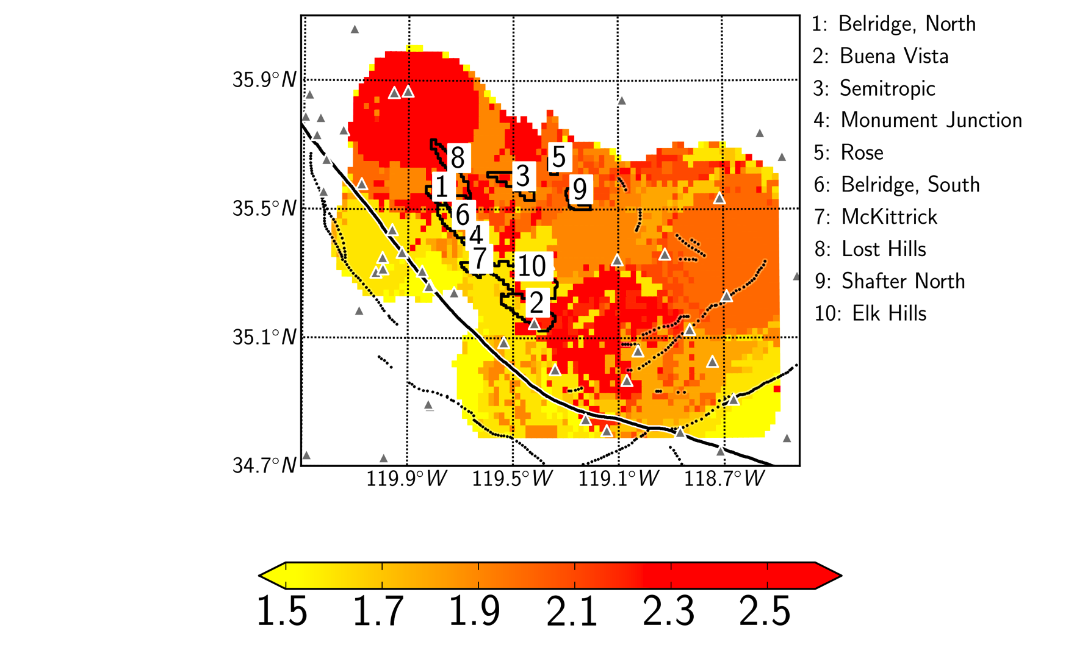
Central Valley
Notes:
Completeness
Fitting G-R relationship -- not Sherlhammer approach
Minimize fit when inverting for Mc and b-value. Use KS distance for fit quality.
Mc low along SAF and Garlock faults
Mc high within basin with Mc in the range M2 to M2.5
Numbers refer to oil fields 1) Belridge;

Slide 17
Conclusions
Why use CISN?
Has in place infrastructure
Has calibrated magnitude scale
Has expertise for data processing
Need for a new CSIN detection capability study
Where CISN needs improved detection:
South Central Valley
Ventura & Santa Barbara Channel
Santa Maria Basin

