Slide 1
ShakeAlert Earthquake Early Warning Progress and Status
Doug Given USGS
Earthquake Early Warning Coordinator
Primary Collaborators
USGS Given, D., Cochran, E., Oppenheimer, D.
State of California (Cal OES, CGS) Johnson, M., Parrish, J.
Caltech Heaton, T., Hauksson, E.
UC Berkeley Allen, R., Hellweg, P., Neuhauser, D.
U. of Washington Vidale, J., Bodin, P.
Swiss Seismological Service, ETH Clinton, J., Behr, Y.
Moore Foundation Chandler, V., Koch, N.
CISN Steering Cmte. Meeting
Oct. 10, 2014

Slide 2
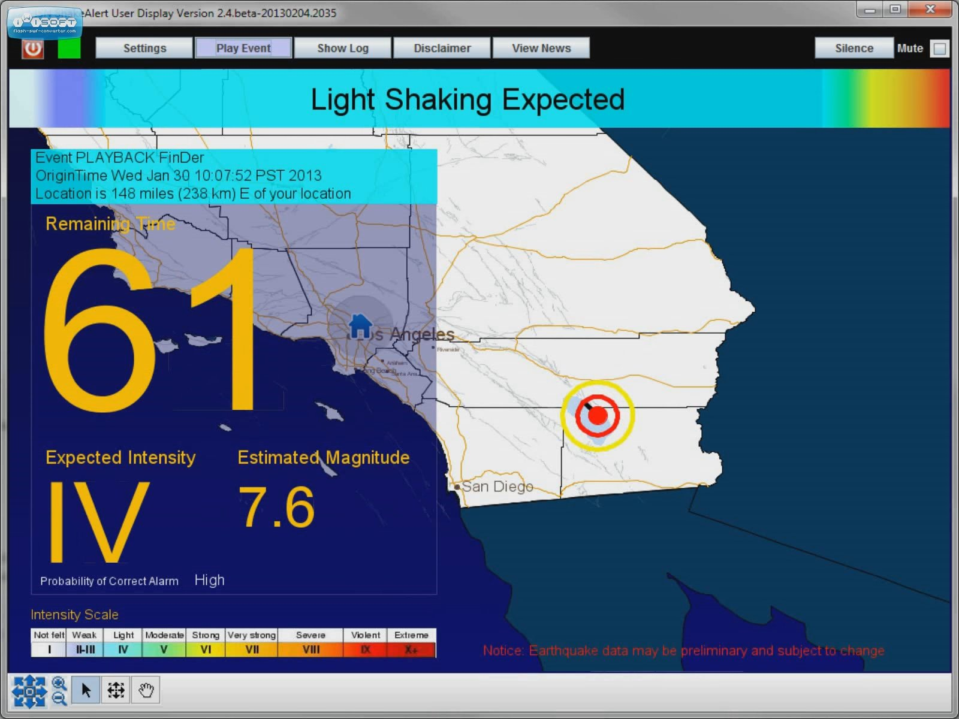
UserDisplay – ShakeOut M7.8 Real-time Finite Fault Solution

Slide 3
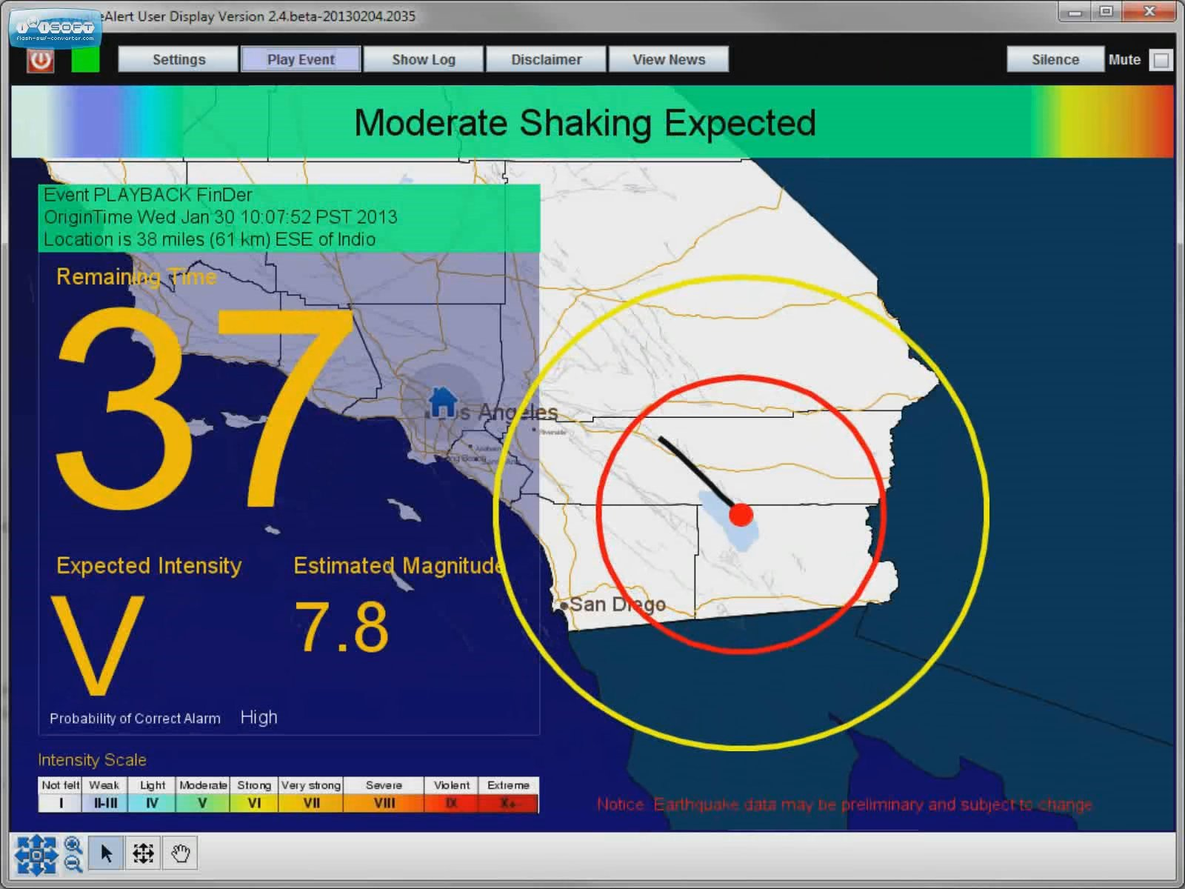
UserDisplay – ShakeOut M7.8 Real-time Finite Fault Solution

Slide 4
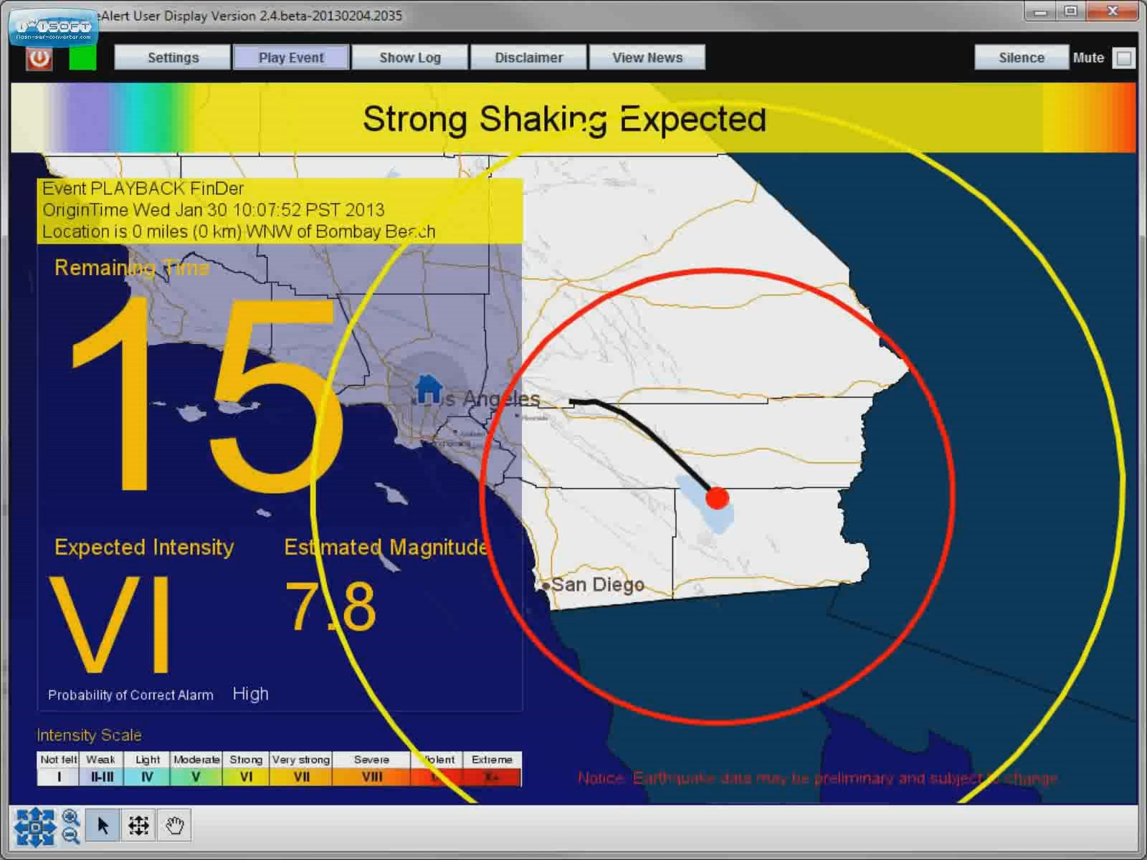
UserDisplay – ShakeOut M7.8 Real-time Finite Fault Solution

Slide 5
UserDisplay – ShakeOut M7.8 Real-time Finite Fault Solution

Slide 6
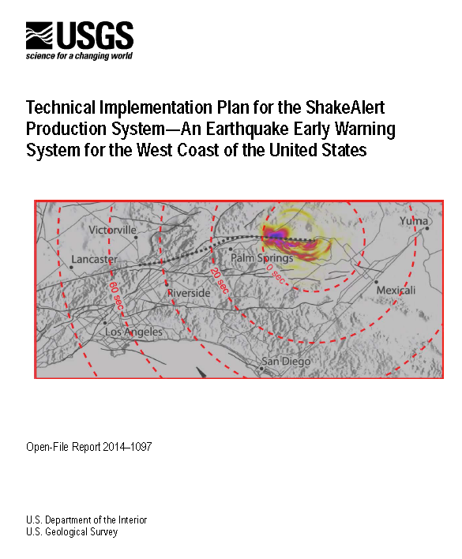
ShakeAlert Plan
Partners plan to complete & operate a the ShakeAlert EEW system to…
Issue public warnings for large earthquakes and…
…send warning parameters to government and private sector users…
…as soon as ShakeAlert meets quality and reliability standards on a region by region basis
Authors
USGS - Given, D., Cochran, E.
CIT - Heaton, T., Hauksson, E.
UCB - Allen, R., Hellweg, P.
UW - Vidale, J., Bodin, P.
Open-File Report 2014-1097
Notes:
Region by region roll out…

Slide 7
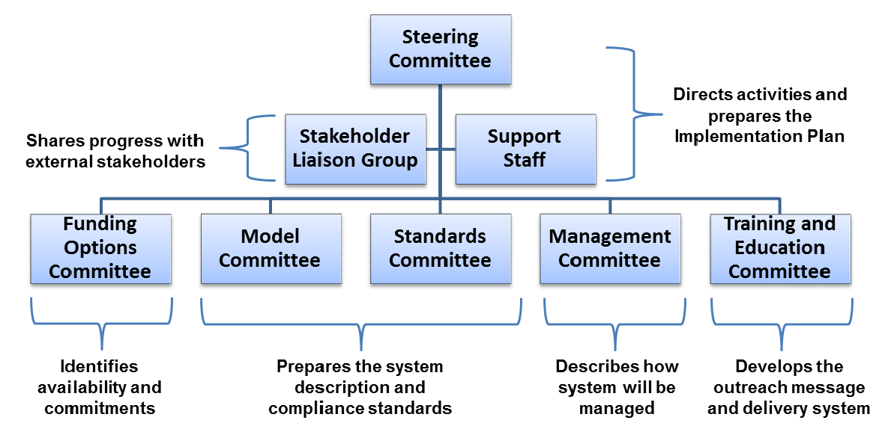
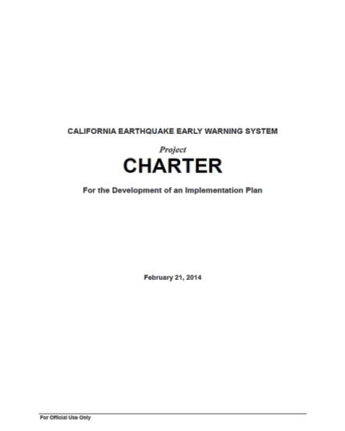
CEEWS: Cal OES – Planning Process CA Code 8587.8: State Implementation Plan by 1/1/2016
“On the road toward a comprehensive earthquake early warning system, we will face some challenges. Fortunately the California Integrated Seismic Network provides us with the foundation for the system we envision.”
- Mark Ghilarducci, Director, Cal OES
Notes:
Signed Sept. 2013.

Slide 8
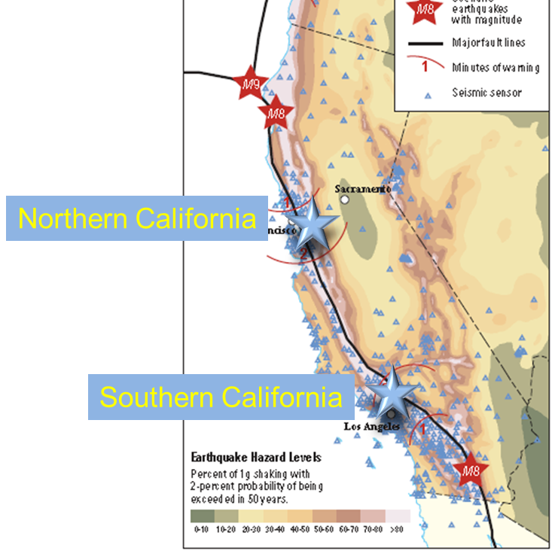
ShakeAlert System Architecture
ShakeAlert in California is built on CISN
Leverages…
Stations
Telecommunications
Hardened centers
Software (EW, AQMS)
Expertise
Management structures
A new CISN product

Slide 9
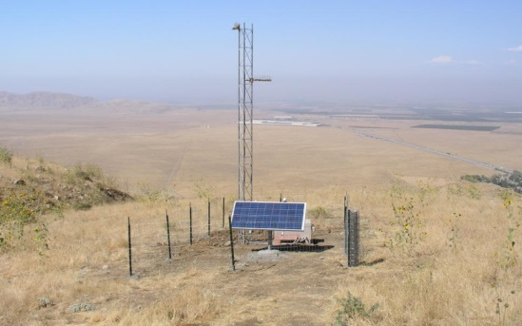
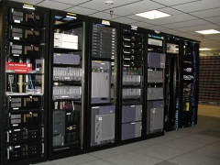
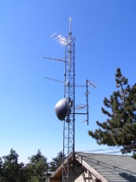
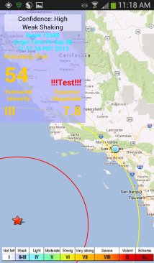
ShakeAlert: Major System Components
Sensor Networks
Processing
Alert Creation
User Actions
Field telemetry
Alert Delivery

Slide 10
CEEWS/ShakeAlert Public - Private Partnership Model
Red = public Blue = private
Partner
Networks
(seismic + GPS)
Waveforms
Parameters
Detections
Direct Users
RT Data
Core System
CEEWS/ShakeAlert Processing
CISN Sensors
(seismic + GPS)
Value-added & Redistribution Services
Alert Streams
Alert streams
Alerts – simple, MMI threshold exceeded
Data feeds – per second, what earth is doing
Public Alert Systems
(e.g. IPAWS)
Notes:
“RT Data” includes waveforms, derived parameters, detections, amps, etc.
“Alert Streams” include any alert product from ShakeAlert from event description streams to simple one-time alerts.
The “Core System” is the system operated directly by CISN.
Direct users are users that receive and use an alert stream without going through a middleman.

Slide 11
Investments in ShakeAlert (Through FY14)
USGS Earthquake Program (2002-2015)
External coops R & D for EEW
Phase I & II (2002-2012) $2,093,851
Phase III (2012-2015) $1,575,000
ARRA California (2009-2011) $4,426,110
- Network equipment upgrades
MultiHazards Project (2008-2014) $2,342,150
TOTAL $10,437,111
Moore Foundation R&D (2012-2014)
Caltech $1,996,888
UC Berkeley $2,040,889
Univ. of Washington $1,848,351
USGS $ 594,406
TOTAL $6,480,534
City of Los Angeles – UASI funding
To Caltech FY 14 (SCSN) $5,600,000 - 125 new & upgraded SCSN stations - 41 RT-GPS stations - System infrastructure upgrades
Future Federal Funding?
Base USGS budget includes $850,000 for EEW
Both House and Senate markups for FY15 include $5 million for EEW
Total = $ 22.5 million

Slide 12
ShakeAlert: Estimated Cost
In addition to current USGS & Cal OES support | California | Pacific Northwest | West Coast Total
Construction | $23.1M | $15.2M | $38.3M
Annual M&O | $11.4M | $4.7M | $16.1M
+
=
+
=
New and upgraded seismic & GPS stations
New and upgraded field telemetry
System testing, certification and performance monitoring
Personnel for maintenance and operation (hardware & software)
Continued R & D
User support and training
Sensor Networks
Processing
Alert Creation
User Actions
Field telemetry
Alert Delivery
Notes:
What’s underfunded? IT security, education and training, user implementation

Slide 13
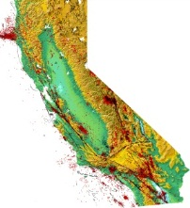
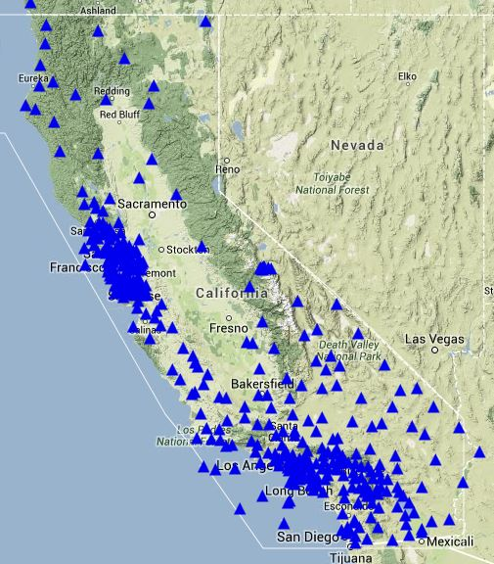
Progress Toward Public EEW
CISN
California Integrated Seismic Network
Shake
Alert
ShakeAlert
Stations
(9/2014)
~400 stations
ShakeAlert Progress
2006-2009 – R & D phase
Jan. 2012 – Demonstration System Live
2015 – Production Prototype
2015* – Limited Rollout
TDB* – Full Operation
*Rollout schedule depends on funding levels

Slide 14
Current ShakeAlert Beta Users
Amgen*
Bay Area Rapid Transit (BART)
Boyd Gaming , Las Vegas, NV*
Cal OES, Warning Center
Caltrans (8 traffic mgmt. centers)
Caltech Safety/Security
Disneyland*
Google.org (crisis response)*
Los Angeles City, EMD, Police, Fire
Los Angeles Co. OEM, Sheriff, Fire
Los Angeles Metro (MTA)
Los Angeles Unified School District
Long Beach EOC, Fire, PD, Waste, Trans.
Long Beach Airport
Metrolink (dispatch)
Metropolitan Water District
Ontario City EOC
Port of Long Beach
Riverside County OEM/Fire
San Bernardino OEC/Fire
San Francisco DEM
San Francisco Fire Dept.
Southern California Edison*
UC Berkeley OEP
Universal Studios / NBC*
US Digital Designs, Inc.*
CRADA’s with:
Global Security Systems*
Early Warning Labs*
* Private company

Slide 15
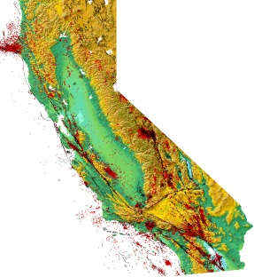
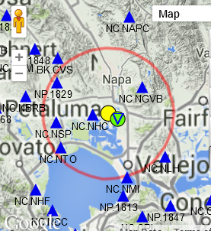
Shake
Alert
Performance Speed and Accuracy
La Habra quake:
M 5.1, March 28, 2014. 9:09 pm PDT
South Napa quake:
M 6.0, Aug. 24th, 2014. 3:20am PDT
ShakeAlert Timeline
09:09:42.3 Origin time
09:09:43.3 (+1.0s) 1st P-wave 09:09:46.3 (+4.0s) 1st Alert
ShakeAlert Timeline
10:20:44.4 Origin time
10:20:49.5 (+5.1s) 1st Alert
Upgraded stations would be faster
4 stations required for alert
Size of “zone of no warning” depends on # stations required to alert
Similar performance for:
M4.4 Encino Event of March 17, 2014
M4.2 Westwood Event of June 2, 2014

Slide 16
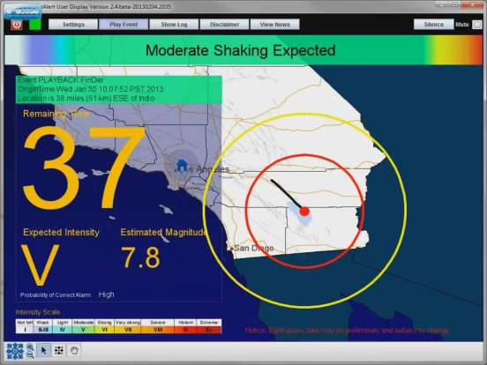
Demo → Production Prototype
Network upgrades, adding station
Upgrade of 125 SCSN stations completed (UASI funding)
Telemeter more CE and NP stations
Port EEW algorithms to CellWorm boxes (NP stations)
Production processing
Standard operating environment defined (Linux)
Six computers installed (NC, BK, CI)
System Testing & Certification
Testing process being defined, computers being installed
Standards being developed and test data gathered
Alerts
Developing code module to send CAP to IPAWS, FIA, etc.
Development by private partners (CRADAs)
Shake
Alert

Slide 17
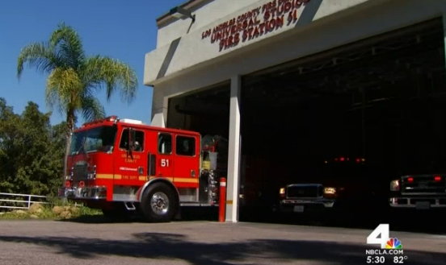
Test Implementation Projects
San Francisco City
Putting UserDisplay in 47 fire stations
Possible private partner involvement
Los Angeles City
Will propose automatic actions at 114 stations
Test in schools (LAUSD)
Possible private partner involvement
Private company demo’ed at LA Co. FD
Applications tolerant of false alerts

Slide 18
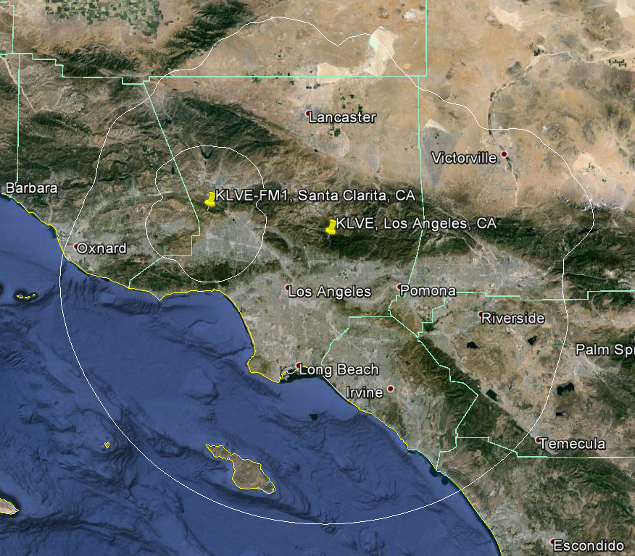
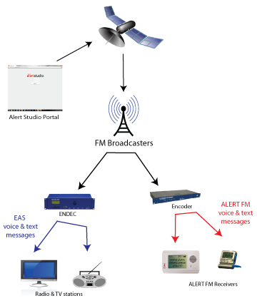
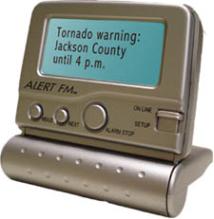
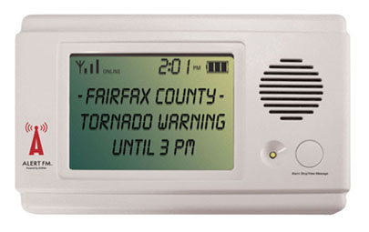
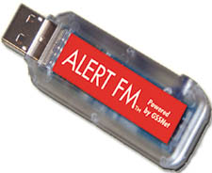
CRADA - GSSNet satellite delivery
KLVE – Univison
Broadcast area
Alerts
Notes:
CRADA

Slide 19
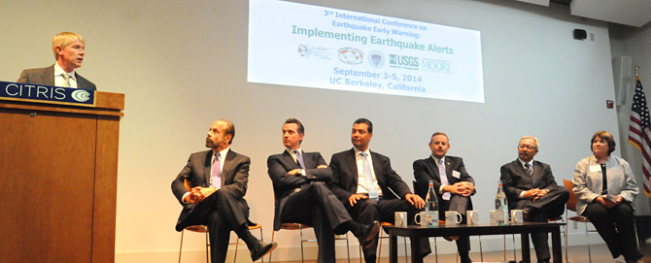
BSL Dir. Richard Allen
CA State Sen. Jerry Hill
CA State Sen. Alex Padilla
SF Mayor Ed Lee
Lt. Gov. Gavin Newsom
CalOES Dir. Mark Ghilarducci
USGS Dir. Suzette Kimball

Slide 20
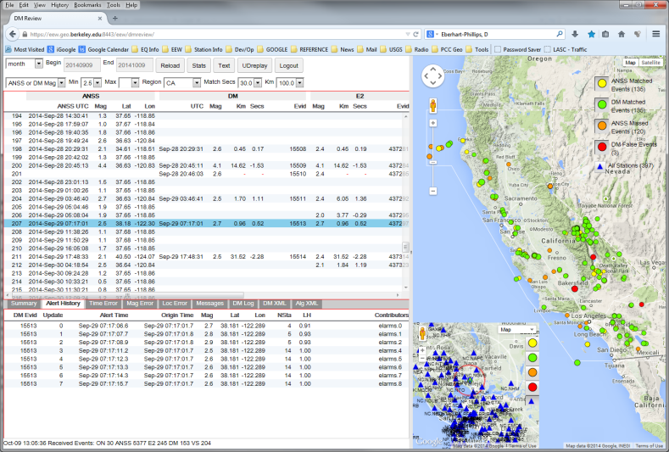
Other ShakeAlert Developments
R & D continuing
Review tool available
Filter bank, ‘gut check’, system evaluation and tuning
RT-GPS - data standards being developed, 4 algorithms in development
Continued work on congressional support
Feinstein – Schiff OpEd, congressional hearings, ‘dear colleague’ letters
Possible $5M add-on in both House and Senate
Ironing out legal issues
Intellectual property (IP)
Private partner agreements
IPAWS Alert Authority completed
CEEWS activity
Shake
Alert

Slide 22
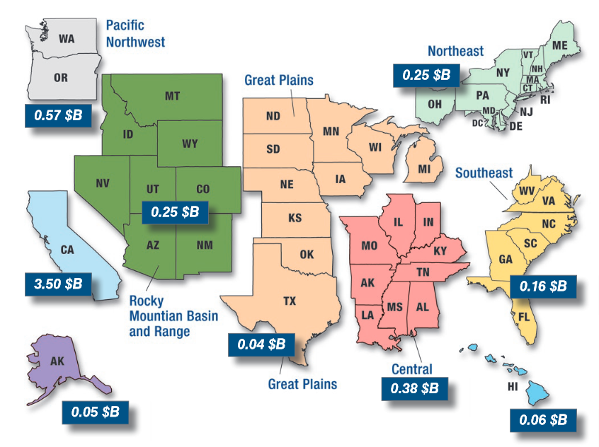
Annualized Earthquake Losses 66% in California, 77% on West Coast
ShakeAlert only needs to prevent 0.4% of direct losses to be cost effective
FEMA 366, April 2008
Notes:
EEW only needs to prevent 0.4% of losses to be cost effective on the West Coast. $16M/yr O&M vs $4.1B/yr loss
Same for Calif. alone. $12M/$3.5B = 0.34%
OR 3 deaths per year (FEMA $6.6M cost of a life)

Slide 23
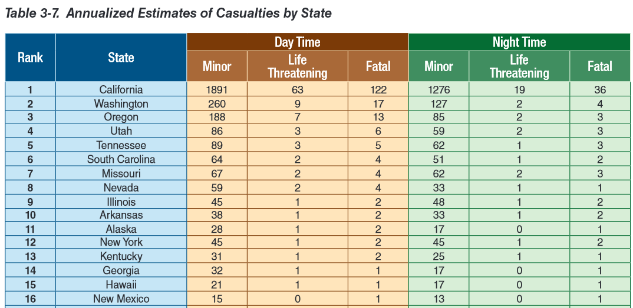
Annualized Casualties by State ShakeAlert cost effective if it prevents ~8% of nighttime and ~2% of daytime fatalities
FEMA 366, April 2008
Notes:
Only need to prevent OR 3 deaths per year (FEMA $6.6M cost of a life)
This roughly equates to ~8% of nighttime fatalities and ~2% of daytime fatalities in California

Slide 24
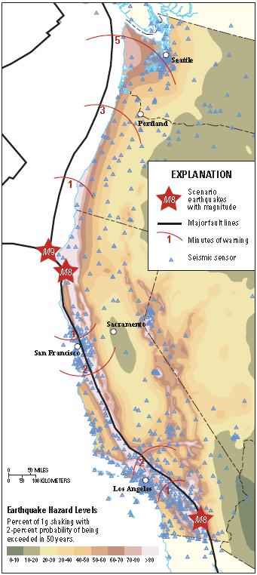
West Coast System Architecture
Pacific Northwest
ShakeAlert is built on ANSS networks (CISN & PNSN)
Leverages…
Stations
Telecommunications
Hardened centers
Software (EW, AQMS)
Expertise
Management structures
A new CISN product
Northern California
Southern California

