Slide 1
State of the CISN: SWOT Analysis
PMG – CISN
Egill Hauksson
CISN Steering & Advisory Meeting,
CalEMA, 25th March 2013
Sacramento, CA

Slide 2
SWOT Analysis
SWOT analysis is a method for analyzing a business, its resources, and its environment
 | Positive Factors | Negative Factors
Internal Factors | Strengths | Weaknesses
External Factors | Opportunities | Threats

Slide 3
SWOT Analysis for CISN
Strength
Existing sensor net.
ARRA upgrade
Monitoring & Research
Data quality/quantity
Weakness
Upgrade ½ completed
Staff turnover
Software verification
User communications
Internal
Opportunities
EEW demand
Existing partnerships
Impact products
Low cost sensors
Threats
Base funding deceasing
New tech. vulnerable/Cell
Users not engaged
Only as good as last quake
External
Positive
Negative

Slide 4
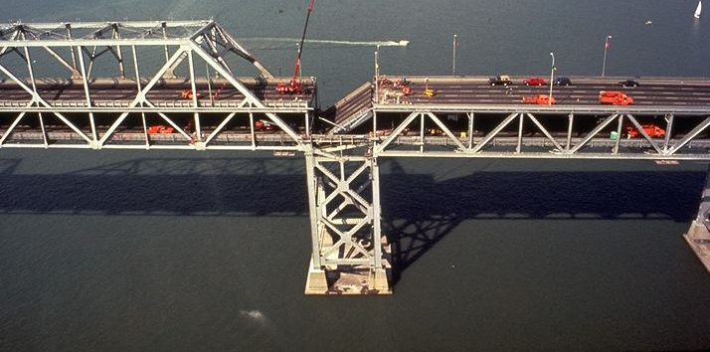
Bottom line: Must Operate During and After the Big One
How do we get there:
Leverage new products that are in high demand by the public to generate new funding streams

