Slide 1
Brief Overview, Current Activities & ARRA Improvements
David Oppenheimer – USGS Menlo Park

Slide 2
What is the CISN?
The California Integrated Seismic Network is a collaborative effort, founded in 2000, to integrate existing, separate California earthquake monitoring networks into a single seismic monitoring system.
The CISN provides the organizational framework to coordinate these earthquake-monitoring operations.
The CISN constitutes the California region within Advanced National Seismic System (ANSS).

Slide 3
Who is the CISN?
Core members have primary responsibility for the recording and monitoring of earthquakes and the creation of CISN products
California Geological Survey
U.C. Berkeley Seismological Laboratory
Caltech Seismological Laboratory
Menlo Park USGS
Pasadena USGS
USGS National Strong Motion Program

Slide 4
Who is the CISN?
Participating members contribute to CISN activities through data exchange.
UC Santa Barbara
UC San Diego
University of Nevada Reno
CA Department of Water Resources
Lawrence Livermore National Labs
Calpine
Cal Energy
Lawrence Berkeley National Labs
PG&E
Plate Boundary Observatory (previously)

Slide 5
CISN Goals
Operate a reliable and robust statewide system to record earthquake ground motions over the relevant range of frequencies and shaking levels
Distribute information about earthquakes rapidly after their occurrence for emergency response and public information
Create an easily accessible archive of California earthquake data for engineering and seismological research, including waveform data and derived products

Slide 6
2005 Funding
Total ~$16M
Notes:
Ucb cut 28%; calema 20%, noaa 100%, usgs- level

Slide 7
CISN Expenditures
2005 Expenditures for California
Seismic Monitoring
Operate and maintain stations
DataCenters
Real-time operations and response
9%
12%
47%
10%
Management
7%
15%
Process improvement
new products
New/Upgraded stations

Slide 8
Current Software Activities
ShakeMap Upgrade
Metadata management (SIS)
Station/Quake XML
Statewide ML analysis
National support of AQMS
Waveform exchange with CGS
RT Double Difference

Slide 9
Station/telemetry Upgrades
ARRA
Caltech -178 stations
UCB – 47 stations
NCSN - 8 stations
Microwave expansion
VA
NSMP – 7 CA hospitals
DOI
NCSN - 5 microwave facilities hardened

Slide 10
Installs/Upgrades CGS SMIP
30 stations installed, 12 in Bay area, 18 in southern California
Downhole arrays each side of Hayward fault and at Oakland end of new Bay Bridge, with Caltrans
SF Rincon Tower underway, with USGS
2 hospitals, Ontario and San Jose, with OSHPD
BART TransBay Tube underway
25 accelerographs installed in Parkfield to replace film recorders

Slide 11
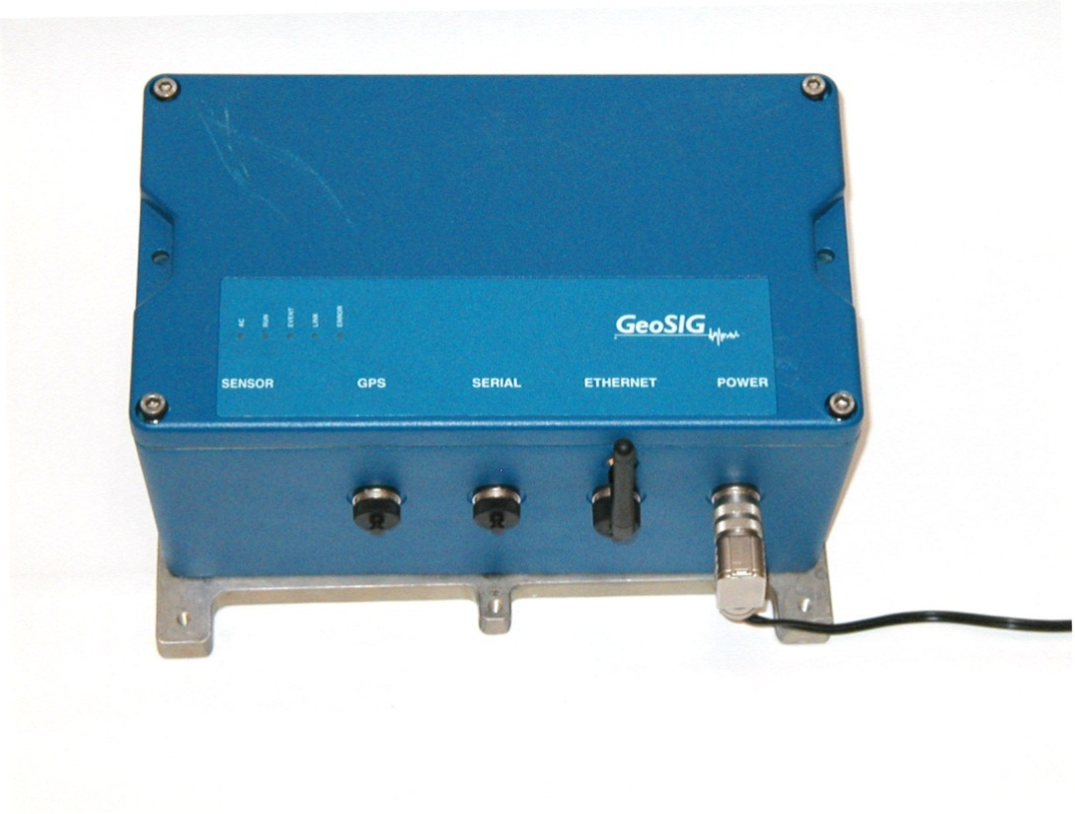
NetQuakes
125 instruments now installed in NC; 50 more in 2012
32 instruments installed in SC; 35 more in 2012
Partnerships with EBMUD, San Diego Gas and Electric, and CICESE
Providing national support for additional 117 installed, 100 in process.

Slide 12
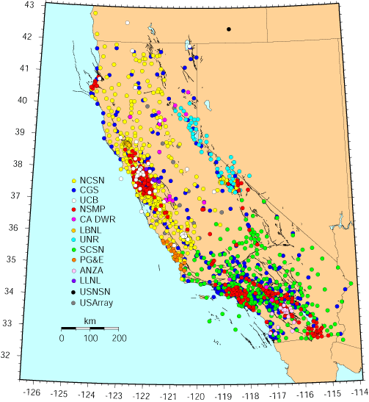
More info at www.cisn.org

