Slide 1
Caltech/USGS Southern California Seismic Network
Egill Hauksson, Caltech
&
Doug Given, USGS Pasadena
CISN Meeting, Sacramento, 14 December 2011

Slide 2
What we risk!
Not reporting on a major damaging earthquake
Making a gap in the continuous earthquake record
Rebuilding new CISN like infrastructure will be much more expensive
The partnerships of emergency responders, policy makers, and scientists may wither
Response & recovery may take longer than necessary
Ongoing training of the public and media may lapse

Slide 3
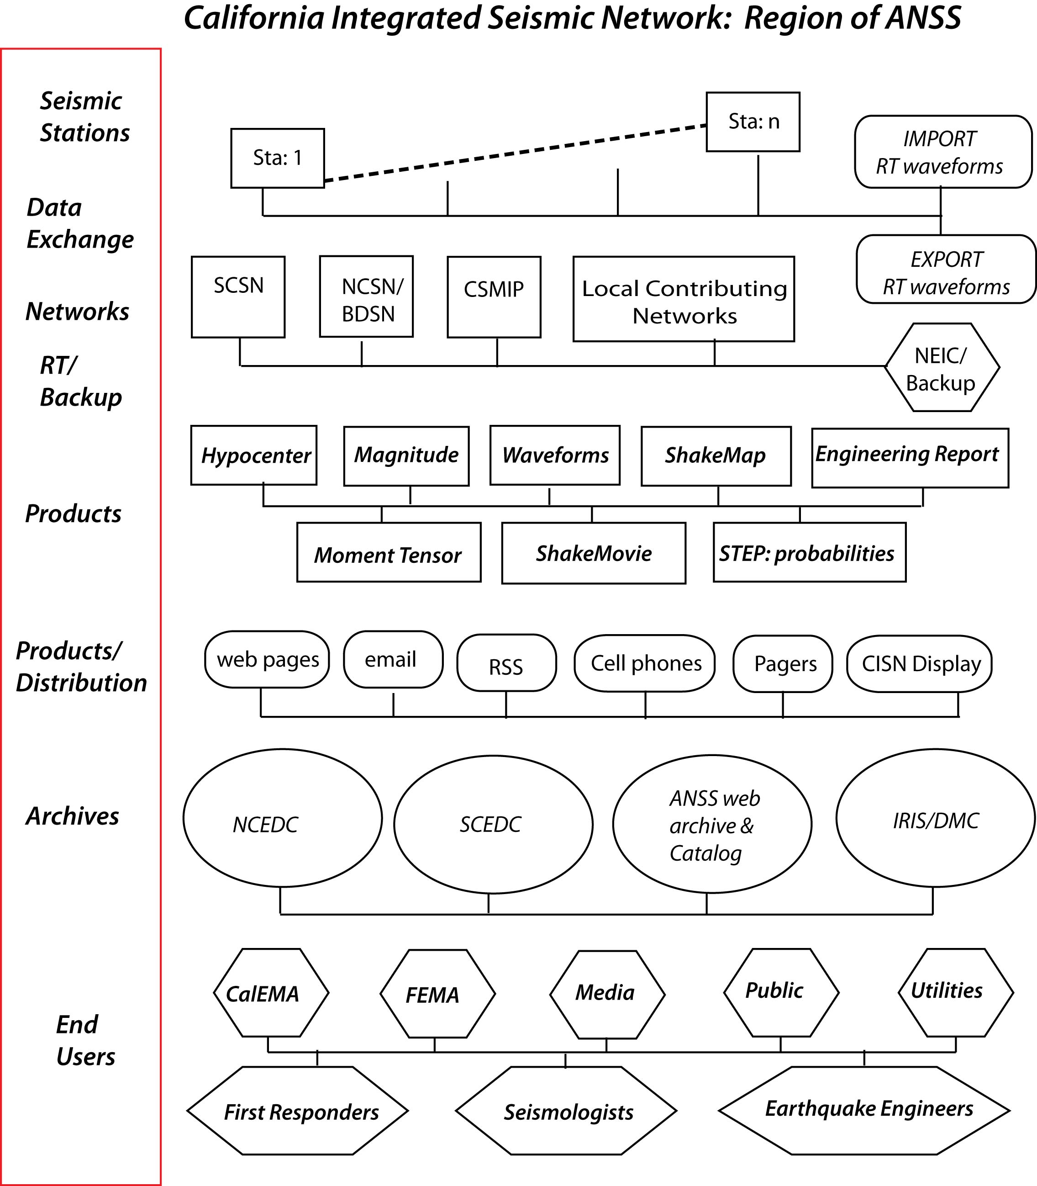
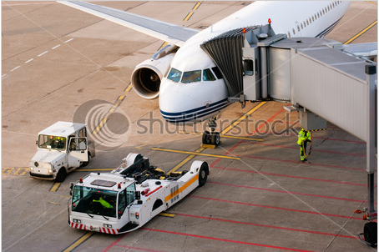

Slide 4
Effects of Gradual Funding Cuts:
CISN T1-ring being decommissioned
Equipment upgrades are lagging
Decreased robustness in telemetry
Statewide exchange of data from stations
Software system updates lagging
Not attempted to implement statewide backup
Staff only “one deep”

Slide 5
New Possible Investments with “other funds”
Replace obsolete “frame relay” data communications technology:
need Cal EMA to approve Caltech for GSA rates
Upgrade of sensor systems from TriNet era
Upgrade 1970s analog stations to contribute data to ShakeMap & EEW
New software systems for alarming, notification, & product tracking
New production versions of EEW software

Slide 6
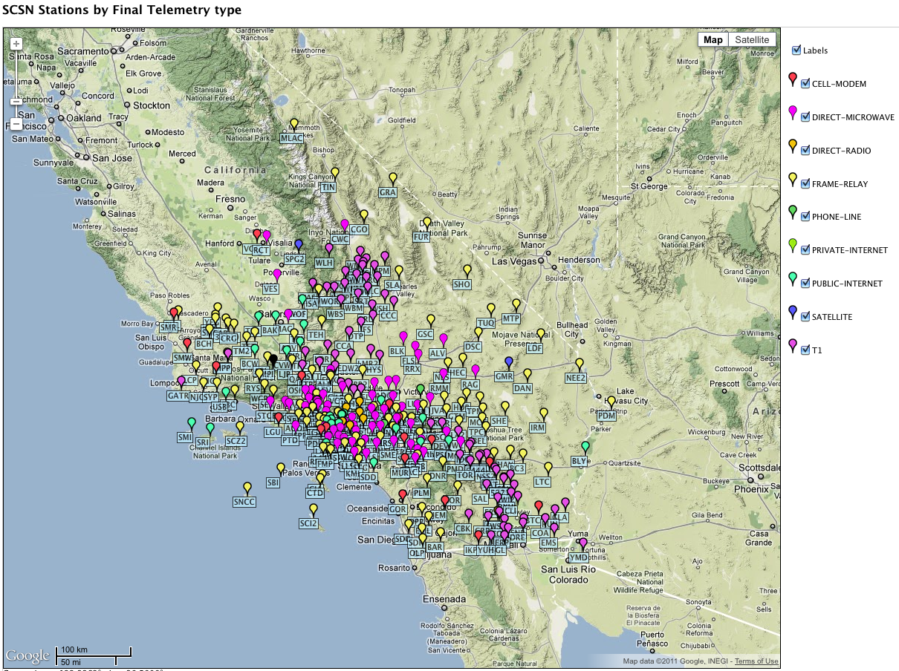

Slide 7
1970s Analog Stations Upgrades

