Slide 1
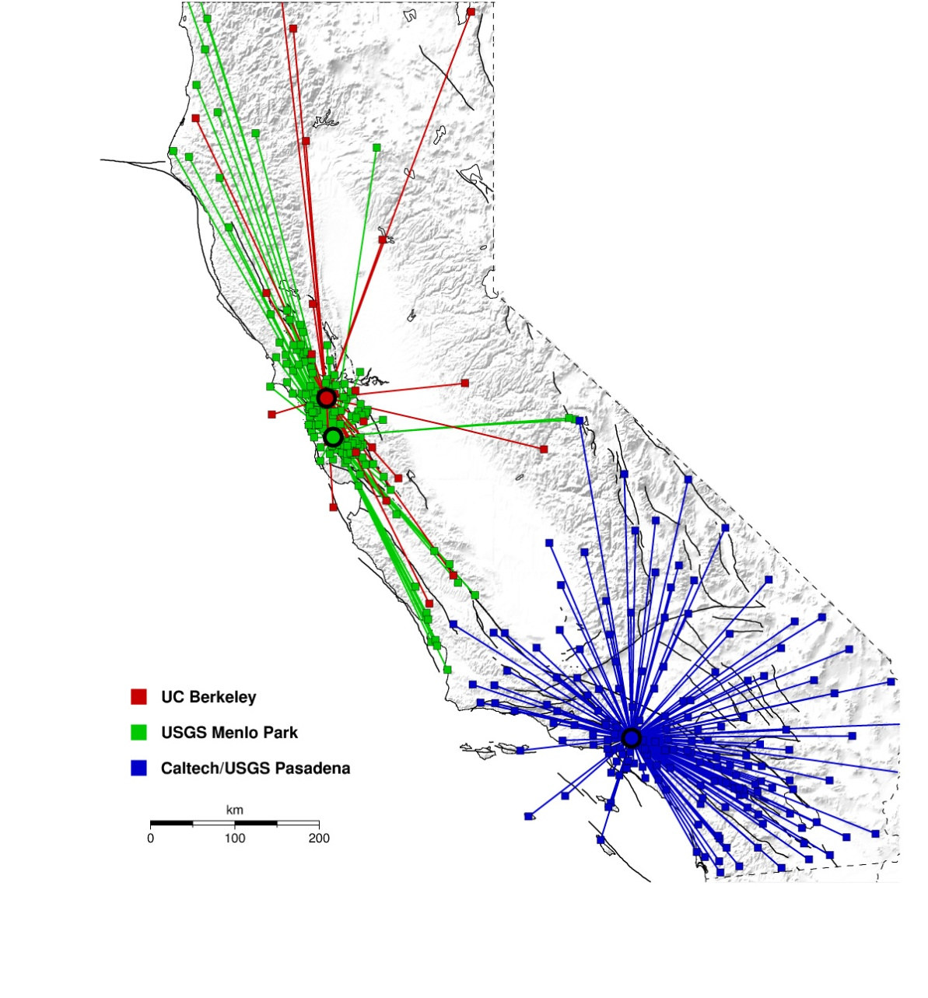
Earthquake Early Warning Research and Development in California, USA
Hauksson E., Boese M., Heaton T.,
Seismological Laboratory, California Institute of Technology, Pasadena, CA,
Given D., USGS, Pasadena, CA,
Oppenheimer D., USGS, Menlo Park, CA,
Allen R. , Hellweg P. ,
Seismological Laboratory, UC Berkeley, Berkeley, CA,
Cua G. , Fischer M. , Caprio M.
Swiss Seismological Service, ETH Zurich
California
Presented at the
European Seismological Commission
32nd Assembly, Sept 6-10, 2010
Montpellier, France
Notes:
Magnitude error estimates based on: 1) 2sigma Gaussian errors for each event and for a set of events. 2) presume these are added

Slide 2
ANSS/CISN Early Warning R&D Project
Collaboration:
USGS
Caltech
UC-Berkeley
ETH, Zurich
USC/SCEC
Develop EEW algorithms to detect and analyze earthquakes within seconds
Identify needed improvements to the existing monitoring networks
Implement an end-to-end prototype test system
EEW requirements:
-- Rapid earthquake detection
-- Early Mag. estimation
-- Ground shaking prediction
-- Robust seismic networks
-- Well trained uses
trigger time
+ 1 sec
+ 3 sec

Slide 3
CISN EEW Algorithm Testing (2007-2009)
Single sensor
Sensor network
Sensor network
τ_{c}-P_{d}
On-site Algorithm
Virtual Seismologist (VS)
ElarmS
Caltech
ETH Zurich/Caltech
UC Berkeley
Progress:
CISN real-time testing of 3 algorithms
τ_{c}-P_{d} On-site algorithm, VS, & ElarmS
State-wide implementation
382 stations with 585 broadband & strong motion
instruments
Many small to moderate earthquakes
2007 M_{w}5.4 Alum Rock & 2008 M_{w}5.4 Chino Hills
2010 Mw7.2 Baja California
CISN EEW Testing Center established
at University of Southern California (USC)/SCEC

Slide 4
CISN EEW Algorithm Testing (2007-2009)
Single sensor
Sensor network
Sensor network
τ_{c}-P_{d}
On-site Algorithm
Virtual Seismologist (VS)
ElarmS
Speed:
Results
> 5 sec ~20 sec ~30 sec
after O.T.
Examples:
M_{w}5.4 Alum Rock: 5 sec before peak shaking in San Francisco.
M_{w}5.4 Chino Hills: 6 sec warning at Los Angeles City Hall.
M_{w}7.2 Baja Calif. 70?? sec warning at Los Angeles City Hall.
Reliability:
Mag.: M_{w}:
± 0.5 ± 0.2 ± 0.4*
MMI: ±0.7
*includes M>7 data from Japan
false alerts:
(M>6.5)
1* 0 0
* three month period

Slide 5
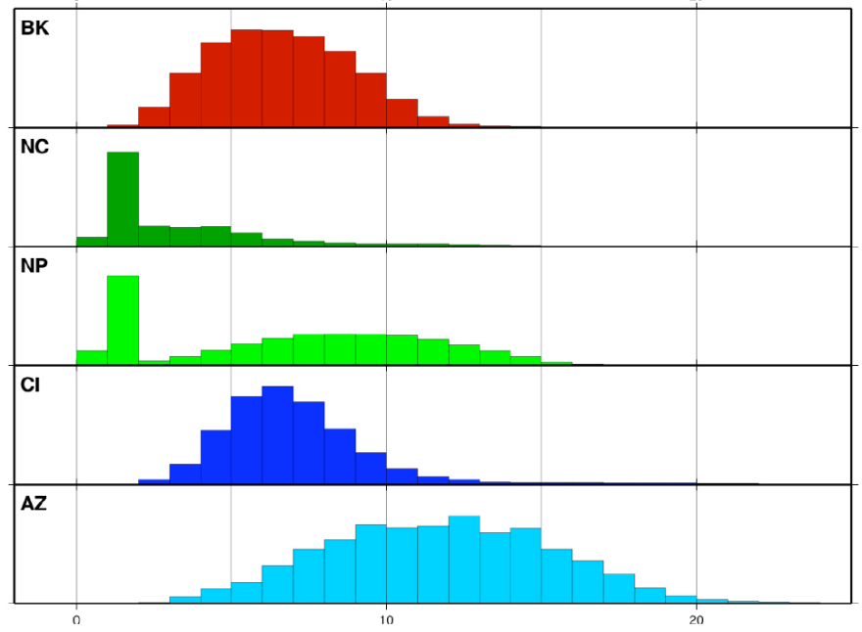
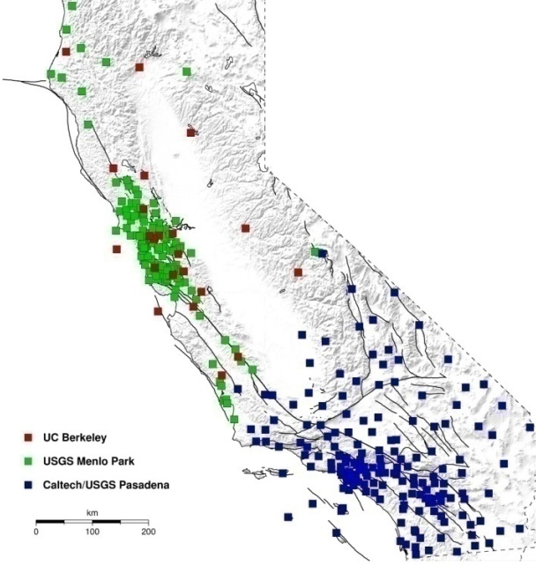
CISN EEW Algorithm Testing (2007-2009)
Single sensor
Sensor network
Sensor network
τ_{c}-P_{d}
On-site Algorithm
Virtual Seismologist (VS)
ElarmS
Speed:
Results
What causes delays?
Data latency (datalogger/telemetry delays)
Station density
Median: ~ 5.2 sec
California
R. Allen
0 10 20 sec

Slide 6
CISN EEW Algorithm Testing (2007-2009)
Single sensor
Sensor network
Sensor network
τ_{c}-P_{d}
On-site Algorithm
Virtual Seismologist (VS)
ElarmS
Results
Speed:
How can these delays be reduced in the future ?
1. reduce data latency
up-grade of ~220 CISN stations with new Q330s
dataloggers (~1-2 sec delay) before Sept-2011
(ARRA stimulus funding)
2. increase processing speed
current delays: ~5 sec
3. Increase station density
Data latency (datalogger/telemetry delays)
Station density
California
R. Allen
0 10 20 sec

Slide 7
(2009-2012)
Alert
CISN Shake
Project Goals
System specifications
Code design specifications
Code development
Define formats and protocols
Year 1 (2009/10):
Implementation
Implement end-to-end processing
Testing with archived data
Testing with real-time data
Improve performance
Testing at the SCEC Testing Center
Testing with selected users
Year 2 (2010/11):
Testing/Optimization
Prototype system in operation
Add features to Decision Module
Research adding GPS RT positions
Research on finite sources
Plans for future systems
Year 3 (2011/12):
Evaluation

Slide 8
(2009-2012)
Alert
CISN Shake
Single sensor
Sensor network
Sensor network
τ_{c}-P_{d}
On-site Algorithm
Virtual Seismologist (VS)
ElarmS
Task 1:
increase
reliability
Decision Module
(Bayesian)
- most probable
… M_{w}
… location
… origin time
… ground motion
and uncertainties
probability of false trigger, i.e. no earthquake
CANCEL message if needed
Bayesian approach
up-dated with time

Slide 9
(2009-2012)
Alert
CISN Shake
Single sensor
Sensor network
Sensor network
τ_{c}-P_{d}
On-site Algorithm
Virtual Seismologist (VS)
ElarmS
Task 1:
increase
reliability
Decision Module
(Bayesian)
Why Bayesian?
maximum speed → few seismic observations → large uncertainties
importance of “expert knowledge” (prior information):
- Gutenberg-Richter magnitude distribution
- aftershock activity
- fault/station locations
- ….

Slide 10
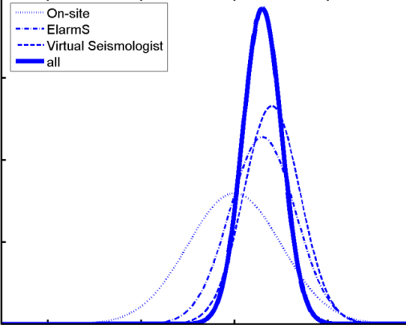
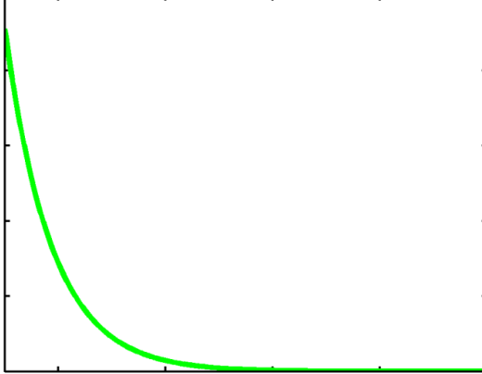
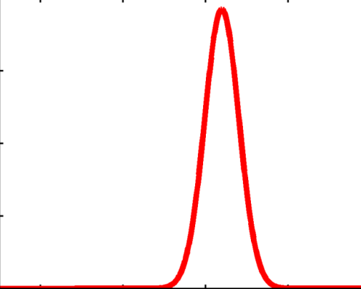
(2009-2012)
Alert
CISN Shake
Single sensor
Sensor network
Sensor network
τ_{c}-P_{d}
On-site Algorithm
Virtual Seismologist (VS)
ElarmS
Task 1:
increase reliability
Decision Module
(Bayesian)
Example:
magnitude
Output
likelihood
a priori probability
here: Gutenberg-Richter
posterior
probability
probability
probability
probability
4 5 6 7 8
4 5 6 7 8
4 5 6 7 8
Magnitude M_{w}
Magnitude M_{w}
Magnitude M_{w}

Slide 11
(2009-2012)
Alert
CISN Shake
Single sensor
Sensor network
Sensor network
τ_{c}-P_{d}
On-site Algorithm
Virtual Seismologist (VS)
ElarmS
Task 1:
increase reliability
Task 2:
demonstrate
Decision Module
(Bayesian)
feed-back
SCEC/ EEW Testing Center
USER Module
- Single site warning
- Map view
Test users
predicted and observed ground motions
available warning time
probability of false alarm
…

Slide 12
(2009-2012)
Alert
CISN Shake
Screenshot of the User Display (preliminary)

Slide 13
Japan Experience

Slide 14
Notes:
Check Georgia notes

Slide 17
7.2

Slide 18
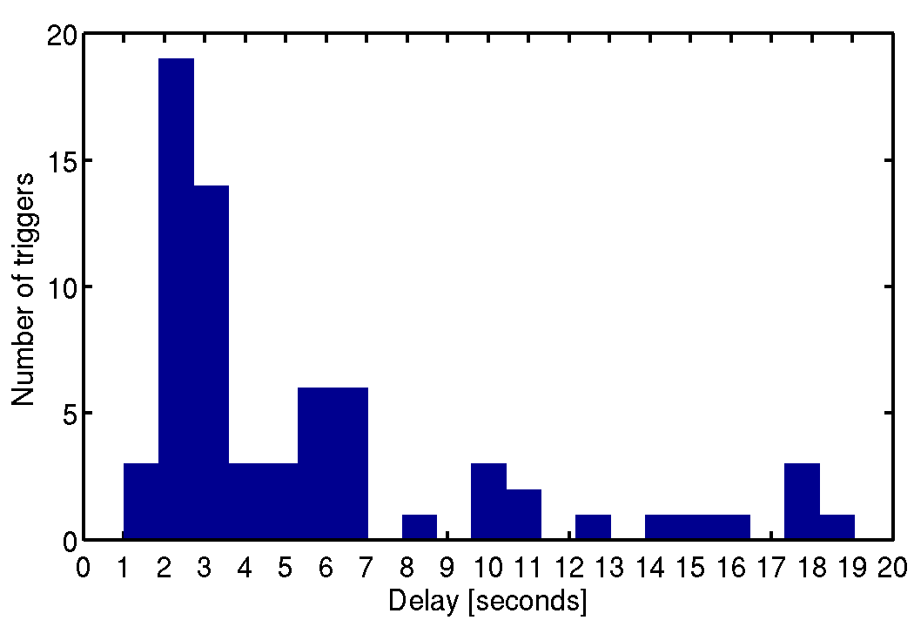
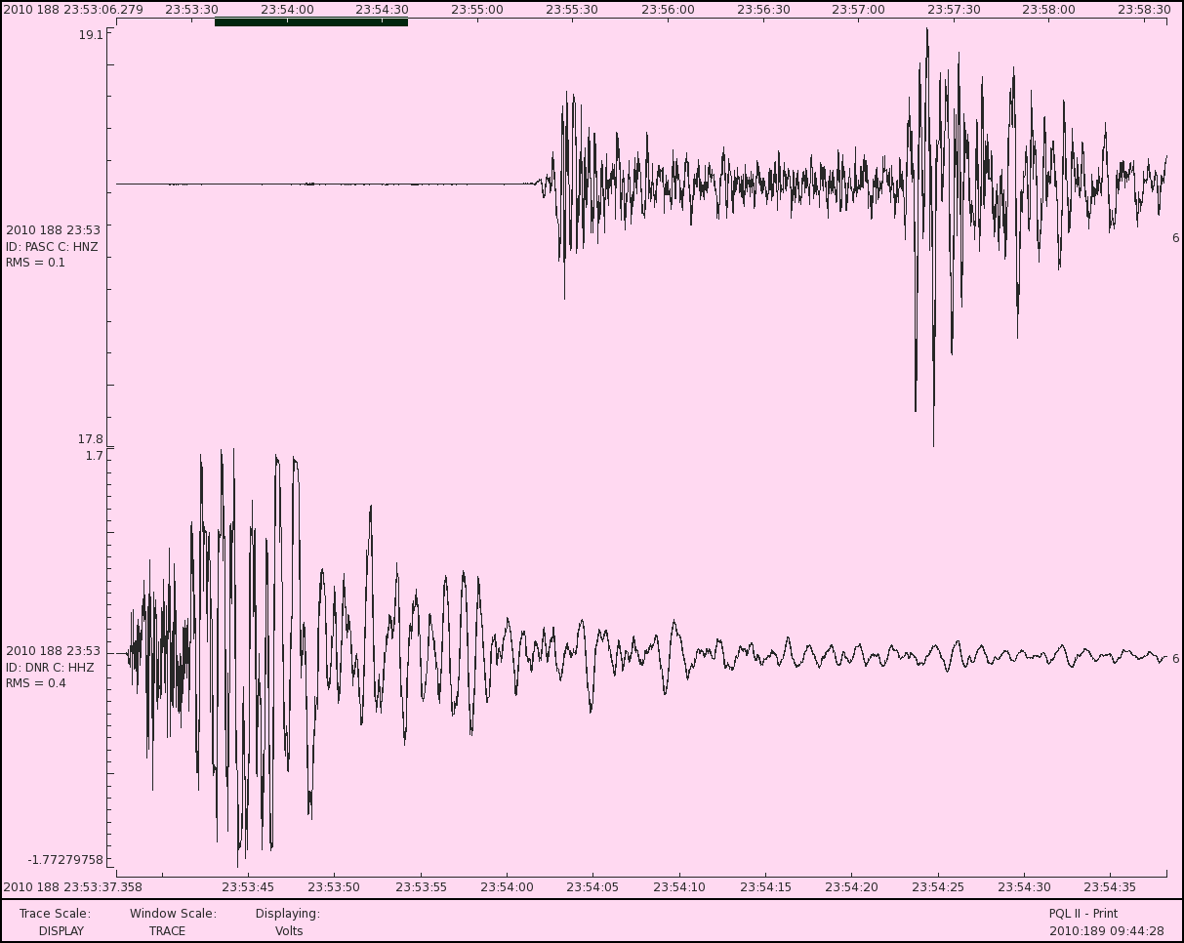
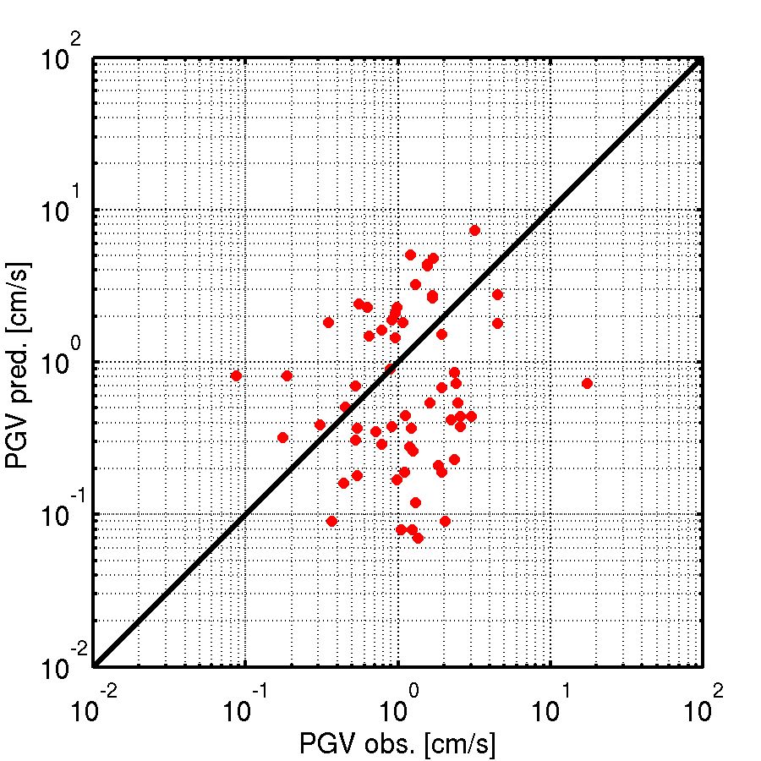
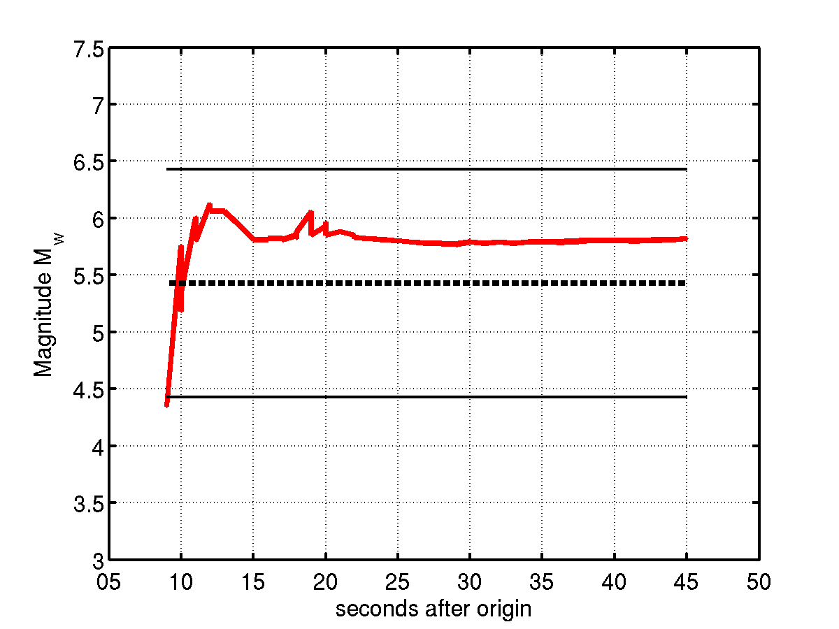
Collins Valley: M5.4 7 July 2010
Notes:
Check Maren’s notes
170 km away and could have had 40 sec warning

Slide 19
Earthquake Early Warning – getting ahead of strong ground shaking
Summary
UC Berkeley
Caltech
U.S. Geological
Survey
USGS/CISN
Phase I (2007-2009)
Algorithm testing
Phase II (2010-2012)
Prototype end-2-end system
Work with test users
Phase II+1/2 (2010-2011)
ARRA funding to reduce datalogger delays
SCEC/USC
CISN
California Integrated Seismic Network

